Slide 1
What You
Need to Know
About Financial Aid

Slide 2
Joe Kauffman
Director of Financial Aid & Student Employment
University of Wisconsin - Stout

Slide 3


Click to ad text
FINANCIAL AID & STUDENT EMPLOYMENT
Notes:
(Placeholder slide while group is getting seated for presentation. Actual presentation would start with the video on the next slide and then the presenter’s introduction.)

Slide 4
Topics We Will Discuss
What is financial aid?
Cost of attendance (COA)
Expected family contribution (EFC)
  Student Aid Index (SAI)
Financial need
Categories, types, and sources of financial aid
Free Application for Federal Student Aid (FAFSA®)
Special circumstances

Slide 5

What Is Financial Aid?
Financial aid consists of funds provided to students and families to help pay for postsecondary educational expenses

Slide 6




What Is Cost of Attendance (COA)?
Tuition and fees
Housing and food
Books and supplies
Transportation
Miscellaneous and personal

Slide 7
What Is Expected Family Contribution (EFC)?
Measurement of student’s and family’s ability to pay postsecondary educational expenses
Student contribution
Parent contribution
(for dependent students)

Slide 8
What Is Financial Need?
Cost of attendance (COA) – Expected family contribution (EFC) = Financial need

Slide 9
Categories of Financial Aid
Need-based aid
Non-need-based aid

Slide 10
Types of Financial Aid
Scholarships
Grants
Loans
Work-Study Employment
Self-Help Aid
Gift Aid

Slide 11
Scholarships
Scholarships
Grants
Loans
Work-Study Employment
Self-Help Aid
Gift Aid

Slide 12
Grants
Scholarships
Grants
Loans
Work-Study Employment
Self-Help Aid
Gift Aid

Slide 13
Work-Study Employment
Scholarships
Grants
Loans
Work-Study Employment
Self-Help Aid
Gift Aid

Slide 14
Loans
Scholarships
Grants
Loans
Work-Study Employment
Self-Help Aid
Gift Aid

Slide 15
Sources of Financial Aid
Federal Government
Employers
States
Private Sources
College and Universities

Slide 16
Federal Government
Largest source of financial aid
Aid provided primarily
on the basis of financial need
Must apply each year using the FAFSA
Eligibility requirements must be met

Slide 17
Federal Student Aid Programs
Federal Pell Grant
Federal Supplemental Educational Opportunity Grant (FSEOG)
Teacher Education Assistance for College and Higher Education (TEACH) Grant
Federal Work-Study (FWS)
Federal Direct Student Loans (Direct Loans)
Iraq Afghanistan Service Grant (IASG)
Federal PLUS Loans

Slide 18
States
Residency requirements usually apply
Aid may be provided on the basis of
both merit and need
Use information from the FAFSA and/or state aid applications
Deadlines vary by state

Slide 19
Colleges and Universities
Aid provided based on both merit and financial need
Aid may be gift aid or self-help aid
Use information from the FAFSA and/or institutional applications
Deadlines and application requirements vary by institution

Slide 20
Private Sources
Foundations, businesses, churches, civic,
and charitable organizations
Deadlines and applications procedures vary
Begin researching private sources early

Slide 21
Employers
May have scholarships available
to the children of employees
May have educational benefits for their employees

Slide 22

Financial Aid Estimator
Early estimation regarding possible Title IV aid available
Requires demographic, income, and asset information

Slide 23
Free Application for Federal Student Aid (FAFSA®)
Collects demographic and financial information
Information used to calculate the expected family contribution (EFC)
Colleges use EFC to offer financial aid
Available in English and Spanish

Slide 24
Free Application for Federal Student Aid (FAFSA®)
May be filed at any time during an academic year, but no earlier than October 1st prior to the academic year for which the student requests aid
For the 2023-24 academic year, the FAFSA may be filed beginning October 1, 2022
Colleges may set FAFSA priority dates

Slide 25




Free Application for Federal Student Aid (FAFSA®)
FAFSA on the Web (FOTW)
Paper or PDF FAFSA
FAA Access to CPS Online
FAFSA on the Phone (FOTP)

Slide 26
Benefits of Using FOTW
Built-in edits to prevent costly errors
Skip-logic allows student and/or parent to skip unnecessary questions
Option to use Internal Revenue Service (IRS) Data Retrieval Tool to import tax data

Slide 27
Benefits of Using FOTW
More timely submission of original application and any necessary corrections
More detailed instructions and “help” for common questions
Ability to check application status online
Simplified application process in the future

Slide 28
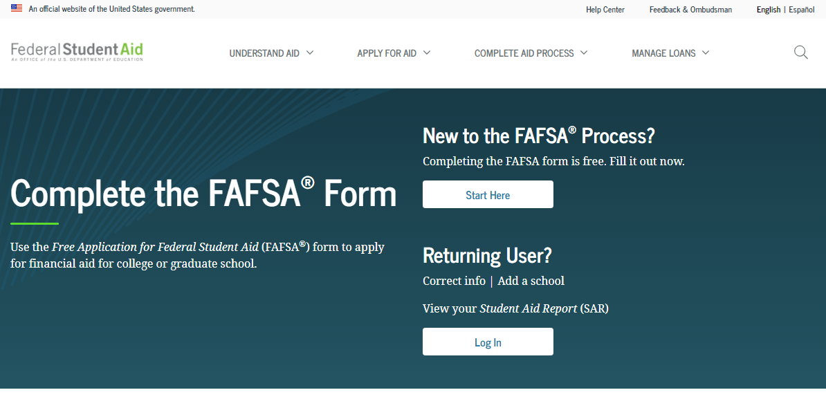
FAFSA on the Web (FOTW)
Website: https://StudentAid.gov/apply-for-aid/fafsa/filling-out

Slide 29
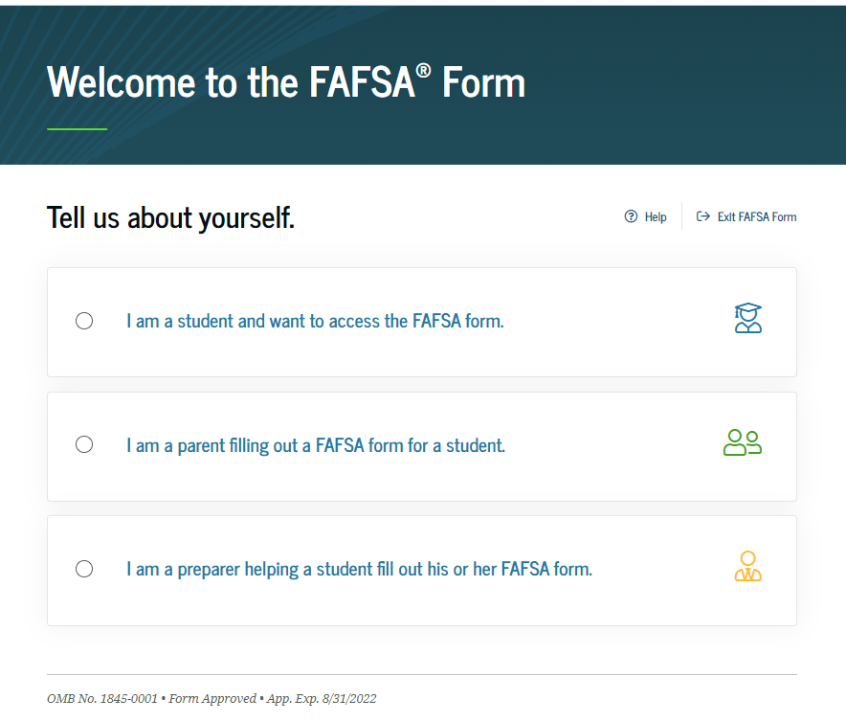
FAFSA on the Web (FOTW)

Slide 30
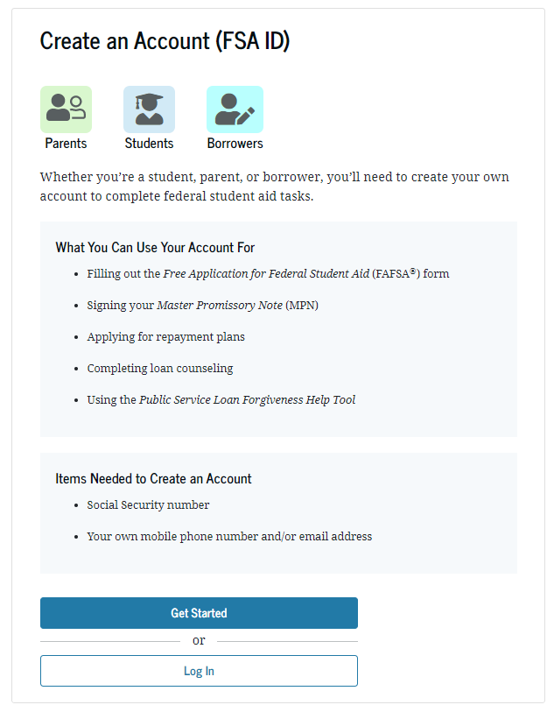
FSA ID
Used for FAFSA completion
and allows access to
certain U.S. Department
of Education websites
Student and parent must
create own FSA ID
May be used throughout
financial aid process,
including subsequent
school years
Only the owner should
create an FSA ID
Apply at https://studentaid.gov/fsa-id/create-account/launch

Slide 31
IRS Data Retrieval Tool (DRT)
Allows for certain tax return information to be transferred from the IRS database
Participation is voluntary and student chooses whether to transfer data to FOTW
IRS will authenticate taxpayer’s identity
IRS transfers information to populate FAFSA income questions, for most tax filers
Reduces documents requested by financial aid office

Slide 32
IRS Data Retrieval Tool
Certain tax filers cannot use the
IRS Data Retrieval Tool
Did not indicate on FAFSA a tax return was completed
Marriage date is January 2022, or later
First three digits of the SSN are 666
Filed a non-U.S. tax return
Married and filed as head of household, or filed separate returns
Neither married parent entered a valid SSN
Non-married parent or both married parents entered all zeroes for the SSN

Slide 33
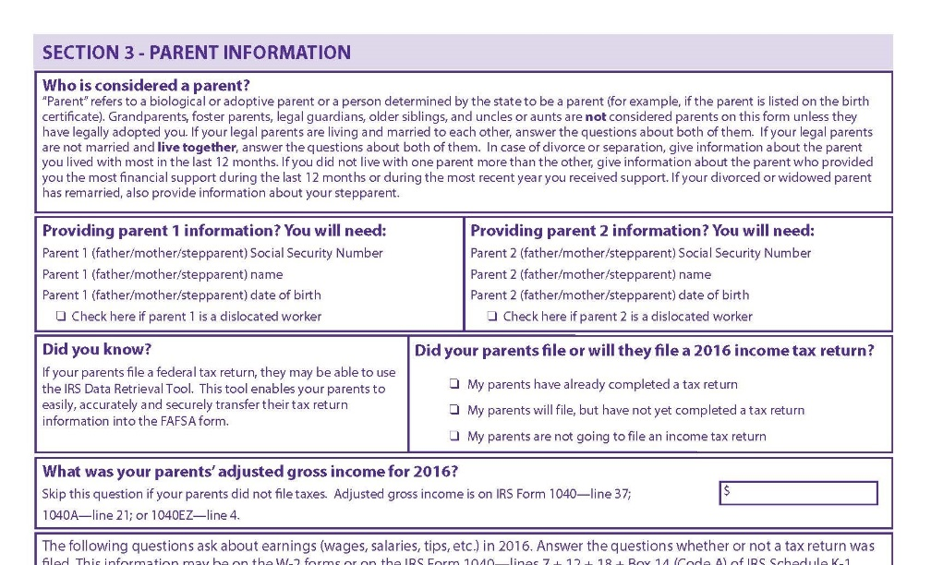
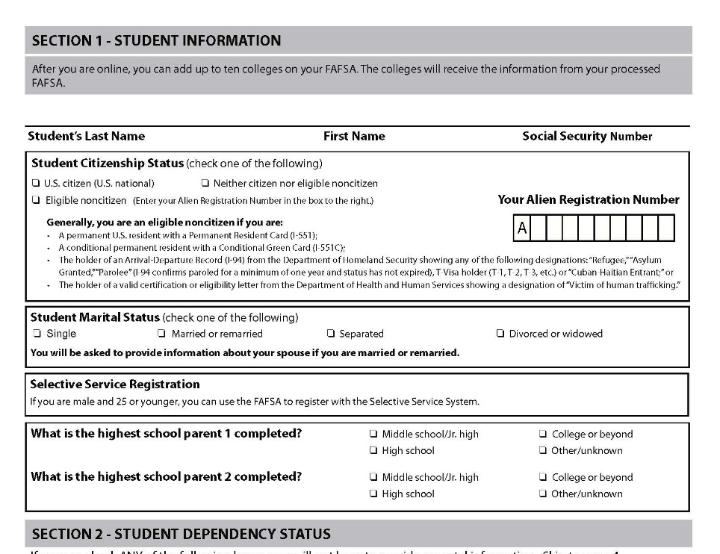
FOTW Worksheet
Preview of questions that may be asked regarding basic information for the student and parent, if applicable

Slide 34
General Student Information
Social Security Number
Citizenship status
Marital status
Highest education level completed by father/mother

Slide 35
Student Dependency Status
FAFSA asks questions to determine dependency status for Title IV federal student aid (not IRS) purposes:
If all “No” responses, student is dependent
If “Yes” to any question, student is independent

Slide 36
Information About Parents
Tax, income, and other financial information
Dislocated worker status
Receipt of means-tested federal benefits in the previous two years
Assets
Untaxed income

Slide 37
Information About Student
Tax, income, and other financial information
Dislocated worker status
Receipt of means-tested federal benefits in the previous two years
Assets
Untaxed income

Slide 38
Additional Information
College information
Housing plans
FAFSA preparer information

Slide 39
Signatures
Required
  Student
  One parent (if considered a dependent student)
Format for submitting signatures
  Electronic using FSA ID
  Signature page
  Paper FAFSA

Slide 40
Frequent FAFSA Errors
Social Security Numbers
Divorced/widowed/remarried parental information
Income earned by parent/stepparent
Untaxed income
U.S. income taxes paid
Asset and investment net worth
Household size
Number of household members in college

Slide 41
Who Is Included in Household Size?
Dependent filers
Student and parent(s)
Student’s siblings and children*
Unborn children and siblings of the student*
Other persons who live in household*
* Included only if receiving more than half support between 7/1/23 to 6/30/24.

Slide 42



FAFSA Processing Results
CPS
College
Student

Slide 43
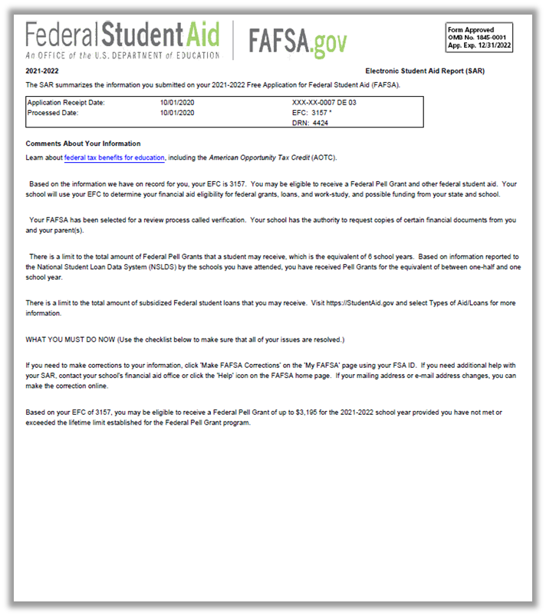
Email Notification of SAR Processing
Form Approved
OMB No. 1845-0001
App. Exp. 12/31/20XX
If valid email address is provided on FAFSA
Provides access to electronic SAR
20XX-20XX
The SAR summarizes the information you submitted on you 20XX-20XX Free Application for Federal Student Aid (FAFSA).
10/01/20XX
10/01/20XX
Based on your EFC of 3157, you may be eligible to receive a Federal Pell Grant of up to $3,195 for the 20XX-20XX school year provided you have not met or exceeded the lifetime limit established for the Federal Pell Grant program.

Slide 44
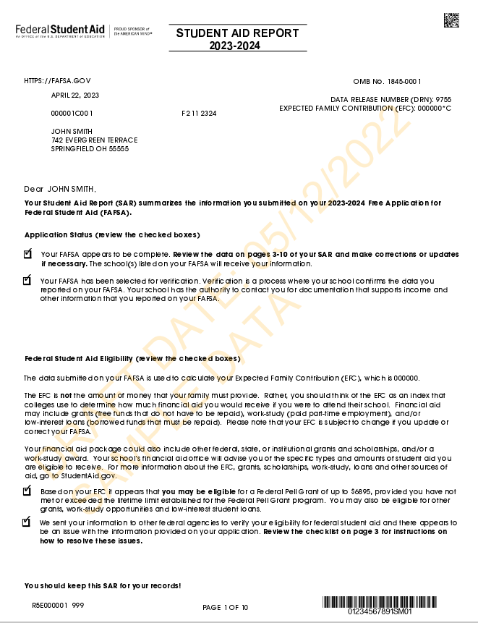
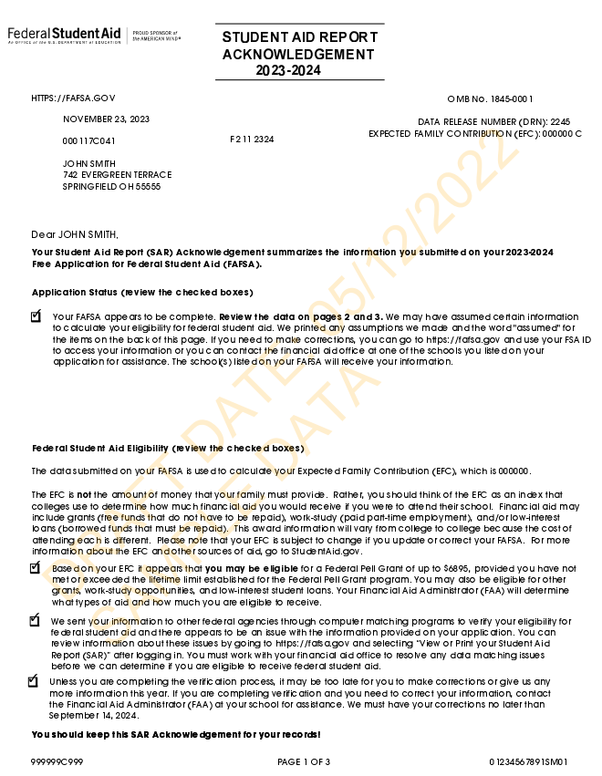
SAR or SAR Acknowledgement
SAR sent if paper FAFSA filed without providing an email address
SAR Acknowledgement sent if FOTW filed without providing an email address

Slide 45
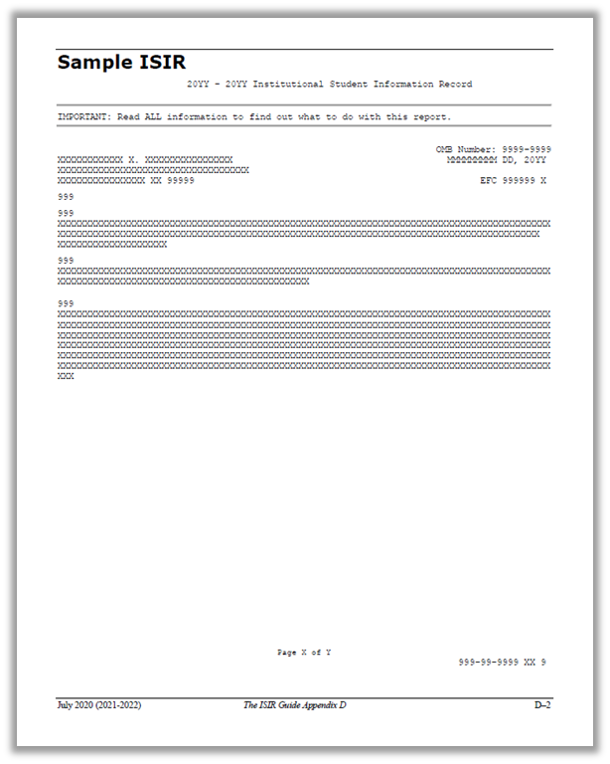
Institutional Student Information Record (ISIR)
CPS sends results to colleges listed on the FAFSA
College reviews ISIR and may request additional documentation

Slide 46
Making Corrections
If necessary, corrections to FAFSA data may be made by:
Using FAFSA on the Web, if student has a FSA ID;
Updating paper SAR; or
Submitting documentation to college’s financial aid office.

Slide 47
Special Circumstances
Conditions exist that cannot be documented with the FAFSA
Send written explanation and documentation to your college’s financial aid office
College will review and request additional information if necessary
Decisions are final and cannot be appealed to U.S. Department of Education

Slide 48

Special Circumstances
Unusual uncovered medical/dental expenses
Secondary school tuition
Extraordinary dependent care
Parent or spouse death
Student cannot obtain parental information
Loss of employment or income
Divorce

Slide 49
Thank you!
Questions??
Office information
finaid1@uwstout.edu
715.232.1363
Presenter:
Joe Kauffman
Director of Financial Aid & Student Employment
University of Wisconsin – Stout

