Slide 1
SOAR Expectations
Lunch Procedures

Slide 2
SOAR Connection Eating healthy and acting properly in the lunch room is a: CHOICE! Verify this claim with a neighbor.
SAFE
ORGANIZED
ACCOUNTABLE
RESPECTFUL

Slide 3
Cafeteria Expectations:
Walk throughout the cafeteria
Keep backpacks and personal belongings out of the way
Do not throw food
Use a conversational voice level
Use cell phones only in the commons or outside during lunch
Clean up after yourself

Slide 4
Lunch Procedures
In the Lunch Line:
Wait your turn in line and avoid blocking the hallway
Never cut in line
Know your PIN
Make sure you have money in your account
If paying in cash, have it out and ready
Deposits made in your lunch account by 2nd hour will be available for that day’s lunch
Take the required items and make good food choices
Pay for the food you take
All food and drink should stay in the cafeteria
Return and neatly stack lunch trays

Slide 5
Lunch Procedures
If Leaving Campus for Lunch:
Watch for pedestrians and bikers. Drive SLOWLY!!!
When walking in the parking lot, please stay to the side along the fence, building or next to parked cars so other vehicles can move in the lanes provided. Walking down the middle of the lane is dangerous to both the driver and the pedestrian.
Use only unlocked doors when re-entering the building
Be respectful of local residents and businesses
Please dispose of all garbage in the cans provided

Slide 6
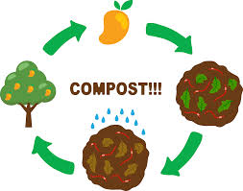
Composting & Food Donation at MHS
Reduces greenhouse gas emissions
Feeds the soil
Reduces the need for chemical fertilizers

Slide 7
On average, 37% of waste a single family throws in the garbage is compostable material!

Slide 8
Composting at MHS
The Eco-Warriors collect
Food Waste
Uneaten fruits and packaged foods for donation to Positive Avenues (a daytime resource center for people who are struggling with homelessness)

Slide 9
What can you compost?
EVERTYHING!!!!!!
(even meat products)
WHAT YOU CAN’T COMPOST
Recyclables (glass, metal, plastic, etc.)
Bones
Paper or cardboard with a wax coating
DON’T WORRY, THE ECO-WARRIORS WILL HELP YOU! ☺

Slide 10
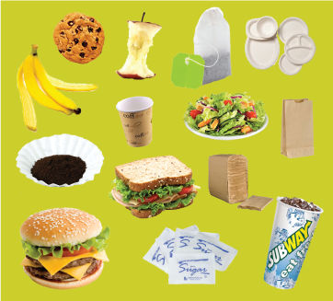
COMPOST! Thanks ☺

Slide 11
SOAR Tip of the Day
Healthy Abes SOAR
It is important to use breakfast and lunch as an opportunity to fuel your body with a variety of healthy foods. Eating too much or too little can negatively affect your mood and classroom performance.
SOAR Goals for the day (and every day ☺):
Choose a healthy meal option while at school.
Eat a healthy breakfast tomorrow morning before arriving to MHS.

