Slide 1
Dear Parents,
Do as many of the activities as you would like with your child, following the directions on each page.
Many of the songs are already familiar, but if they aren’t, there is a link on each page that will play you the song. Have fun!
All the best,
Mrs. Swartz

Slide 2
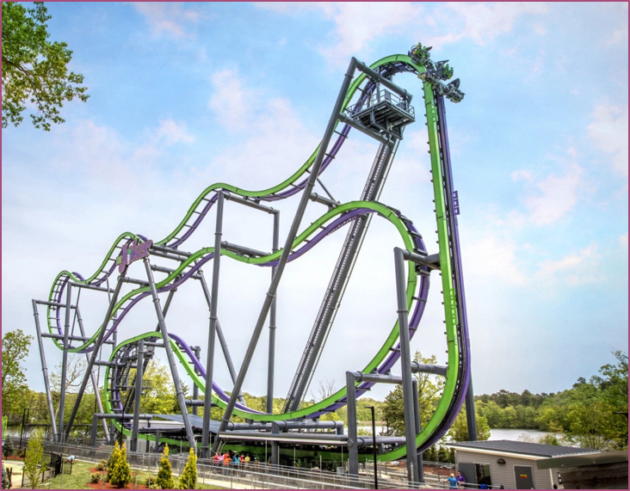
Follow the roller coaster with your voice. Try to do it different way – fast, slow, silly voice, monster voice.

Slide 3
Echo Singing – echo on the “Hey, Hey!”
Click on speaker and then play to hear recordings
Lucy Rabbit – hey, hey
In my garden – hey, hey
Cut my collards – hey, hey
Cut my carrots – hey, hey
Cut my turnips – hey, hey
All night long – hey, hey
Shoo rabbit way - hey, hey SHOO!
What other things might Lucy eat in a garden?
Can you add echo parts to the song and sing them for a family member?

Slide 4
Silly Songs with actions.
Make actions to each verse.
Click on speaker and then play to hear recordings
The Wheels on the Bus go
‘round and round (x3)-arms go in circle
The Wheels on the Bus go
‘round and round, all through the town.
The Horn on the Bus go
Beep, beep, beep! (x3)-press the horn
The Horn on the Bus go
Beep, beep, beep! All through the town.
Wipers go swish, swish, swish. (hands swish)
Driver says move on back. (thumb points over shoulder)
People on the bus go up and down.(move up and down)
Baby on the bus says, “wah, wah, wah.” (pretend cry)
Mommy’s on the bus says, “Sh, sh, sh.” (finger to mouth)
1st-2nd Grade
Make up your own verses and actions!

Slide 5
Arioso
Arioso Land is what we call it when as a class, we hold conversations using our singing voice.
What we want to use is our high, light singing voice to work the muscles so that children learn to use their whole voice and not just the heavy voice we use when talking.
Ideas for Arioso
Have the child hold a conversation with a stuffed animal about…
What they ate for breakfast
What they want to do with a friend
Read a book in a singing voice
Click on speaker and then play to hear recordings

Slide 6
Keeping the Beat
Find a favorite song,or use the one in the link.
Show the beat by tapping your legs, floor, a parent approved item, or clap.
Whatever you do, make sure you can hear the music.
2nd Grade
Can you play the
Du-De Du-De rhythm to the song?
Click on speaker and then play to hear recordings

Slide 7
Click on speaker to hear recording
Song Tale – Had a Little Rooster
Song Tales are sung stories for you child to listen to – after a few listens, they may sing along on the parts that repeat, if they’d like.
Bonus activities with Song Tales:
*have them tell you what they think the story is about.
*Ask them to tell what happens first, then second, and then last.

