Slide 1
Academic Career Planning Presentation
Northstar Middle School

Slide 2
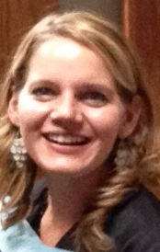
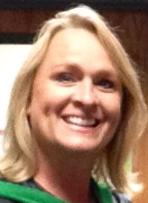
Introductions
Northstar Middle School
Student Services Department Counselors
Ms. Jenni Berg
A-J
Ms. Lisa Sproul
K-Z

Slide 4
Post Secondary Readiness
Planning for the future :
Explore interests, aptitude, and use feedback to begin developing an academic and career plan.
Align interests and aptitude with academic courses.
Utilize programs of study to prepare for high school registration.
Understand the importance getting involved and keeping options open as a part of good planning.
If you have additional questions specific to your family, please contact your student’s counselor- Ms. Jenni Berg (A-J)- 715-852-5119 or Lisa Sproul (K-Z) -715-852-5118 to set up an individual conference.

Slide 5
Information to consider
Interests
Assessments and Inventories
Occupational Searches
CareerLocker
Grades
Skyward Family Access
Testing
Spring 2016

Slide 6
Assessments
Composite Score
College Readiness
Plans for After High School
ACT --Explore
Assessments:
FORWARD at 8th grade
ASPIRE at 9th grade
Prepare for ACT/SAT
Prepare for Compass

Slide 7
Career Locker (WisCareers)
www.wiscareers.wisc.edu
User Name-Student ID
Password – Last Name
Registration code: nms-c834

Slide 8
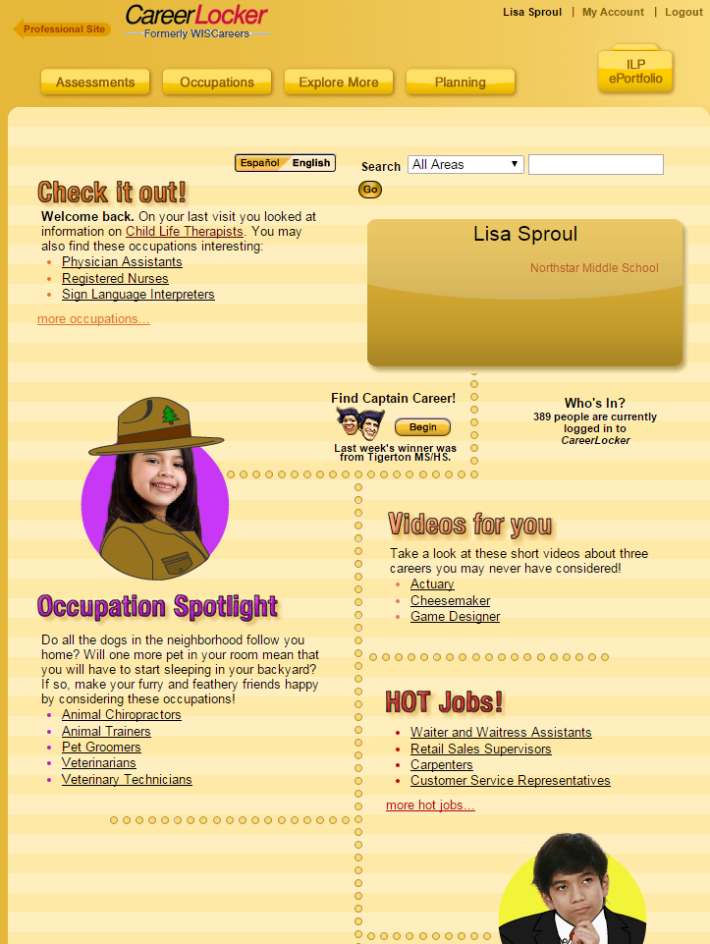
Career Locker
Your personal locker
Home page updates as you use
Suggests new sites
Save occupations and college information
Begin resume

Slide 9
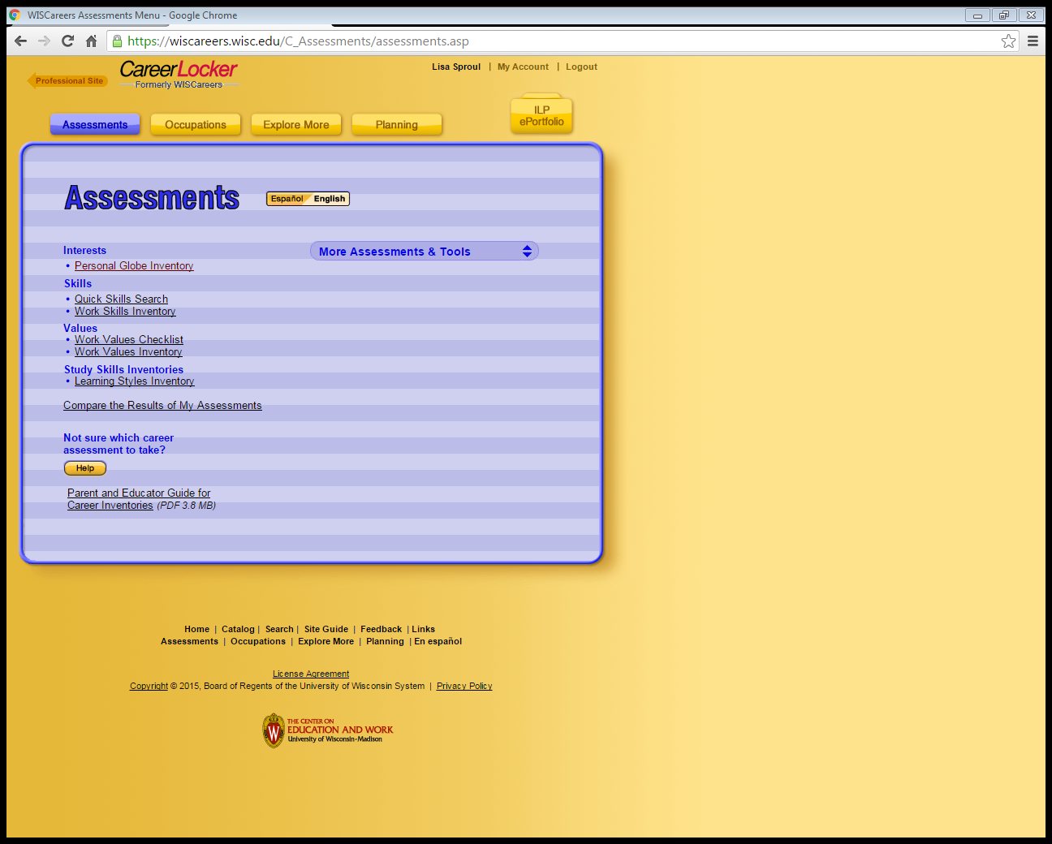
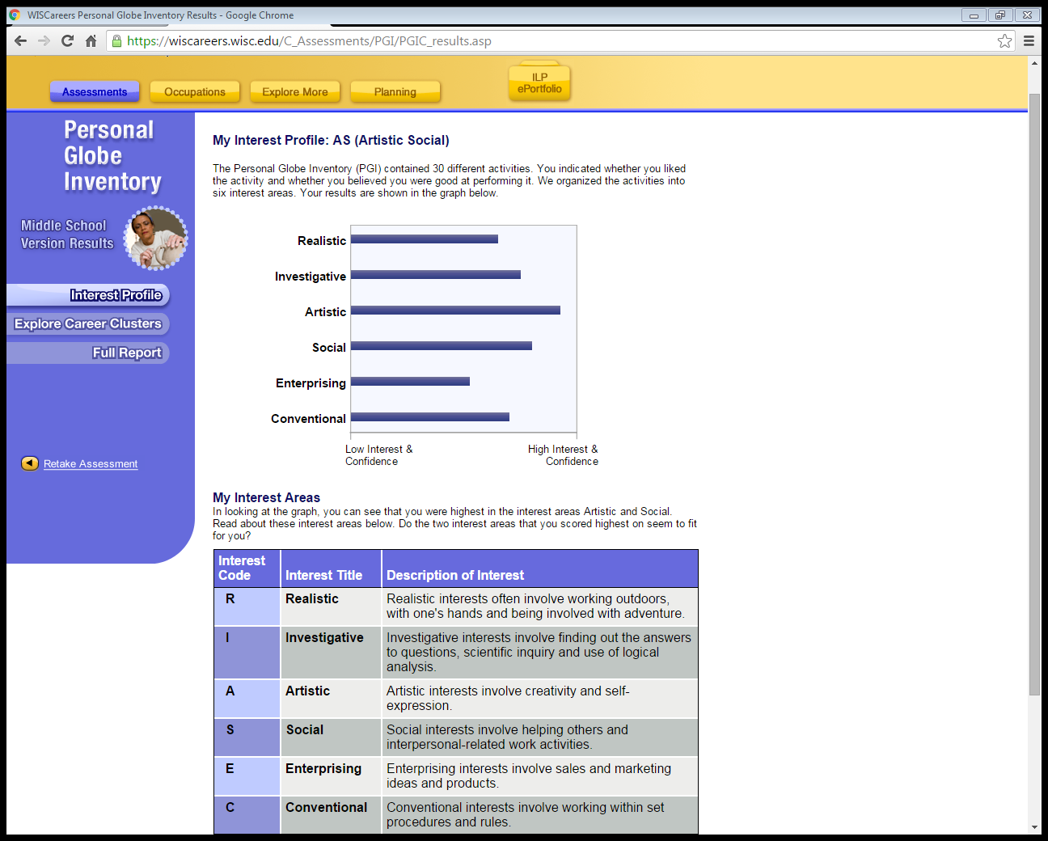

Slide 11
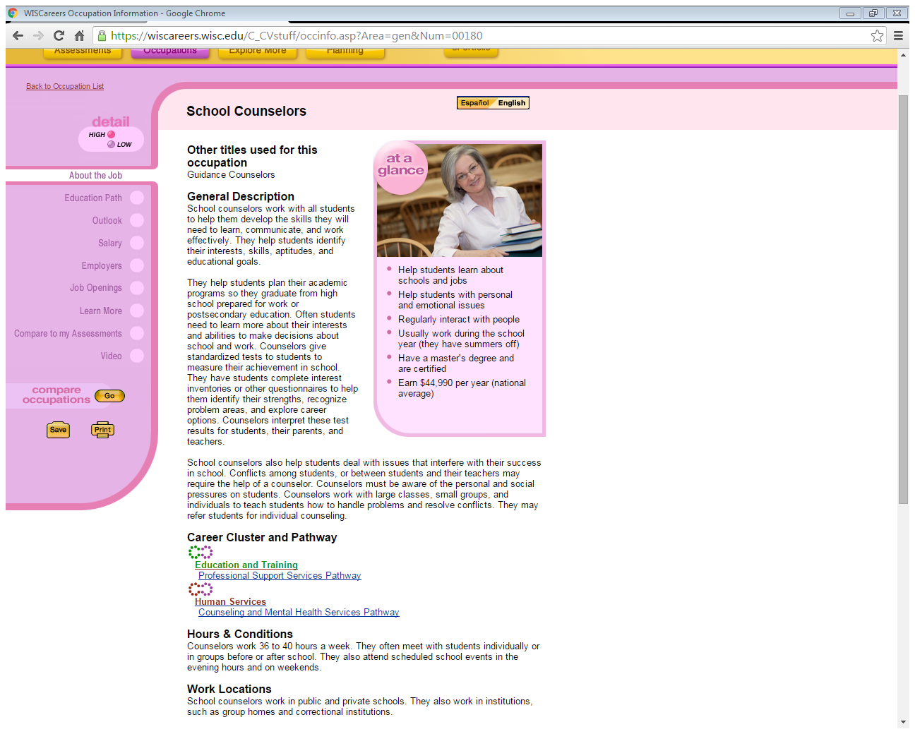

Slide 13
Career Pathways and Career Clusters
Career Clusters and Their Pathways
The Eau Claire Area School District and its partners have developed several Programs of Study to serve as guidance tools for our students.
Sixteen Career Clusters and Their Pathways
http://www.ecasd.us/District/Departments/Teaching-and-Learning/High-School-(9-12)/Programs-of-Study/Career-Clusters
North Website under Student Services

Slide 14
Career Clusters and Pathways Webpage

Slide 15
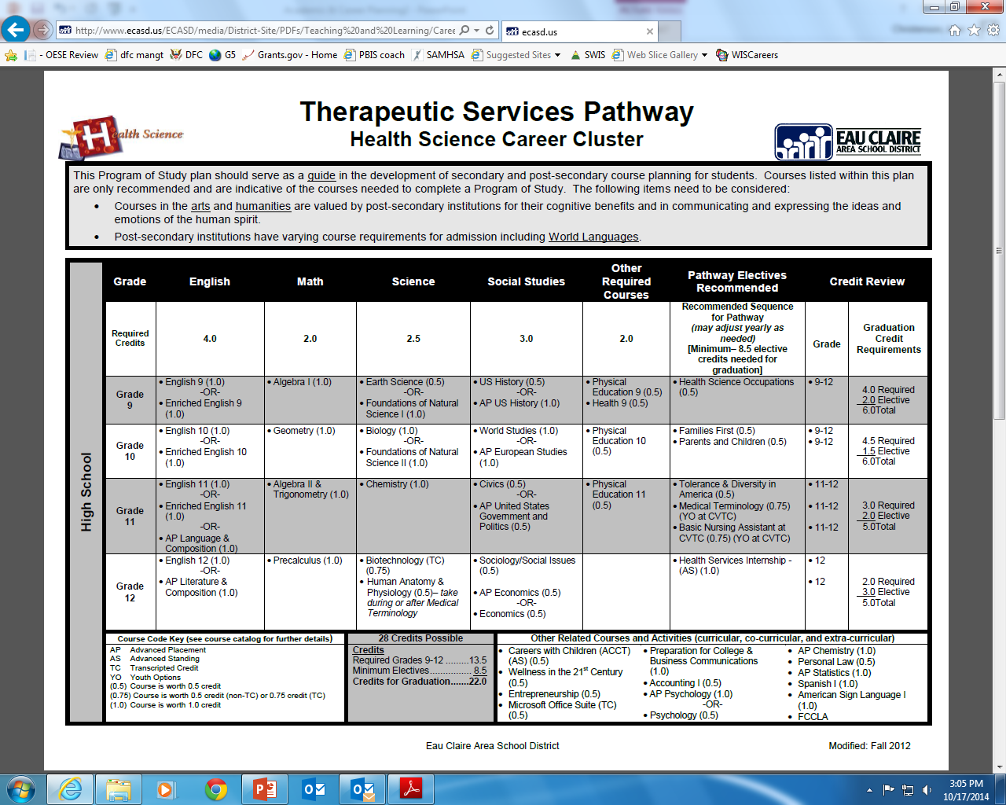

Slide 17
Academic and Career Planning Guide
(The Course Catalog)
Academic and Career Plan for Post-Secondary Success
ECASD graduation requirements
4 year college/university admission requirements
My Academic and Career Plan for Post-Secondary Success
4 year course plan for high school

Slide 18
Academic and Career Planning Guide
(North Course Catalog)
Each student gets a hard copy
The course catalog is also available
on NHS’s website
Be sure to read through the sections
that precede the course descriptions

Slide 19
What do I need to graduate
from North?
English 4.0 credits
Social Studies 3.0 credits
Math 3.0 credits
Science 3.0 credits
PE 1.5 credits
Health .5 credits
Electives 8.5 credits
TOTAL 23.5 credits MINIMUM!

Slide 20
What do I need to be college eligible
and prepared for life after high school?
English 4.0 credits
Social Studies 3.0 credits
Math 3-4 credits*
Science 3.0+ credits
*Effective Fall 2015-University of Minnesota schools require
4 credits of Math to be admission eligible

Slide 21
Registration Card

Slide 22
Registering for High School
High School Registration materials handed out
January 7th – High School Counselors at Norhtstar Middle School – 2:00pm
Parent Night
January 11th - North High School – 6:00-7:30pm
High School Registration
January 15th – Northstar Middle School computer lab during science class
High School Counselors will be at Northstar for the day
Signed registration forms to be turned in

Slide 23
Volunteering/Community Service
Career Venture
Opportunity to learn from Professionals in the field
Volunteering / Community Service
National Honor Society
Scholarships
Sports/Clubs/Groups
Important to get involved!!!!!

Slide 24
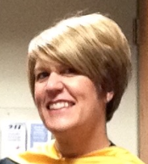
Contact Information
Need more information?
Call or email the student services office to make an appointment
jschilling@ecasd.us
715-852-5103
Ms. Jennifer Schilling
Student Service Secretary/Registrar

