Slide 1
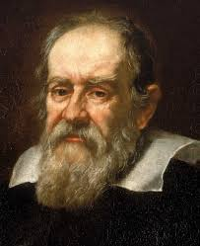
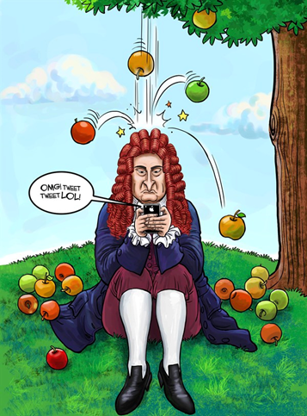
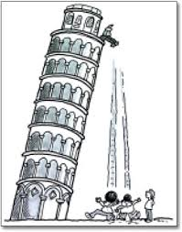
Free Fall

Slide 2
What is meant by Free Fall?
Free Fall: A state in which the only force acting on an object is the gravitational force

Slide 3
What is the acceleration due to gravity?
On average the acceleration due to gravity, g = -9.80665 m/s² at sea level
(varies between 9.78 and 9.83 at locations on the earth’s surface)
For simplicity we will use 9.8 m/s²

Slide 4
Galileo’s Hypothesis
First asserted by Galileo
“At a given location on the earth in the absence of air resistance all objects fall at the same uniform acceleration.”

Slide 5
Consequences of Galileo’s findings
Acceleration is always – 9.8 m/s², g (assuming + is up)
For an object dropped or tossed up the velocity at the top is always zero.
Initial speed up is equal to the final speed down when compared at the same height.

Slide 6

Same Equations: substitute Y for X and g for a
Constant Acceleration Equations
Free Fall Equations
$ΔX=\frac{1}{2}at^{2}+v_{o}t$
$v=at+v_{o}$
$v^{2}=2aΔX+v_{o}^{2}$
$ΔY=\frac{1}{2}gt^{2}+v_{o}t$
$v=gt+v_{o}$
$v^{2}=2gΔY+v_{o}^{2}$

Slide 7
