Slide 1
Graph types

Slide 2
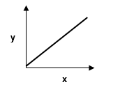
Proportionality (Linear)
y is proportional to x
y α x (short-hand notation)
The graph of a proportional relationship is a straight line with a non-zero slope.

Slide 3
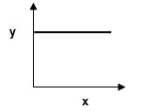
Constant or Independent Relationship (Linear)
y is independent of x
The graph of an independent relationship is a straight line with zero slope (horizontal line).

Slide 4
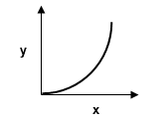
Top opening parabola
y is proportional to x²
y α x²

Slide 5
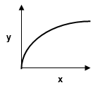
Side opening parabola
y² is proportional to x
y² α x

Slide 6
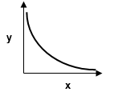
Hyperbola
y is proportional to 1/x
y is inversely proportional to x
y α 1/x
(could also be y α 1/x²)

