Slide 1
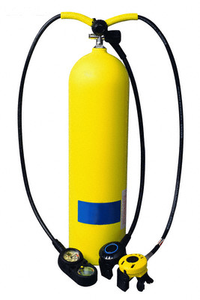
Ideal Gas Law

Slide 2
Describing a sample of a gas
4 variables are needed to completely describe a sample of a gas:
Temperature
Pressure
Volume
Amount (number of moles) of gas

Slide 3
Gas Constant
At STP 1 mole of any gas has a volume equal to 22.4 L
So if you have 1.0 moles (number of moles),
V= 22.4 L T = 0ºC or 273K P = 1 atm
PV = 0.0821 Liter⋅Atm = R
Tn
Mole⋅K

Slide 4
Ideal Gas Law
PV = R Multiply both sides by Tn
Tn
PV = nRT where R is the ideal gas law constant. If three of the variables are known, the 4th can be determined.
The units of R depend on the units used for P, T, and V.

Slide 5
Units of R
Two common values of R:
0.0821 Liter⋅Atm
8.31 Liter⋅KPa
Mole⋅K
Mole⋅K

Slide 6
Problem-Solving
Most commonly used value of R:
0.0821 Liter⋅Atm
Note:
Pressure must be in atm
Volume must be in liters
Temperature must be in Kelvins
Mole⋅K

Slide 7
Ideal Gas Law Problems
What pressure is exerted by 0.75 moles of nitrogen gas at 25°C in a container with a volume of 1.5 L?
Find the volume of 0.85 moles of gas at a pressure of 520 torr and a temperature of 15°C.
How many grams of carbon dioxide are present in a sample at 700 torr, 333°C, and occupying a volume of 452 mL?

Slide 8
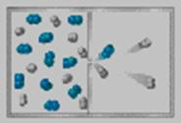
Effusion
gas
vacuum

Slide 9
Effusion
Process where molecules of a gas confined in a container randomly pass through a tiny opening in the container.
Rates of effusion can be used to determine the molar mass of a gas.
Kinetic energy of molecules in a gas depends only on temperature and equals ½ mv².

Slide 10
Effusion
Two gases at the same T have the same average KE:
½ M₁V₁² = ½ M₂V₂²
Note: This V is the velocity of the molecules, NOT the volume of the container.
V₁² = M₂
V₂² M₁

Slide 11
Effusion
Two gases at the same T have the same average KE:
½ M₁V₁² = ½ M₂V₂²

Slide 12
Graham’s Law of Effusion
The rates of effusion of gases at the same pressure and temperature are inversely proportional to the square roots of their molar masses.
The heavier gases move more slowly.

Slide 13
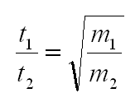
Effusion
Recall: the faster you are going, the less time it takes you to get somewhere.

