Slide 1
Boyle's Law
If n and T are constant, then
PV = k
This means, for example, that
Pressure goes up as Volume goes down.
A bicycle pump is a good example of Boyle's law.
As the volume of the air trapped in the pump is
reduced, its pressure goes up, and air is forced
into the tire.
Robert Boyle
(1627 - 1691)
Son of Earl of Cork, Ireland.

Slide 2
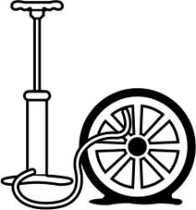
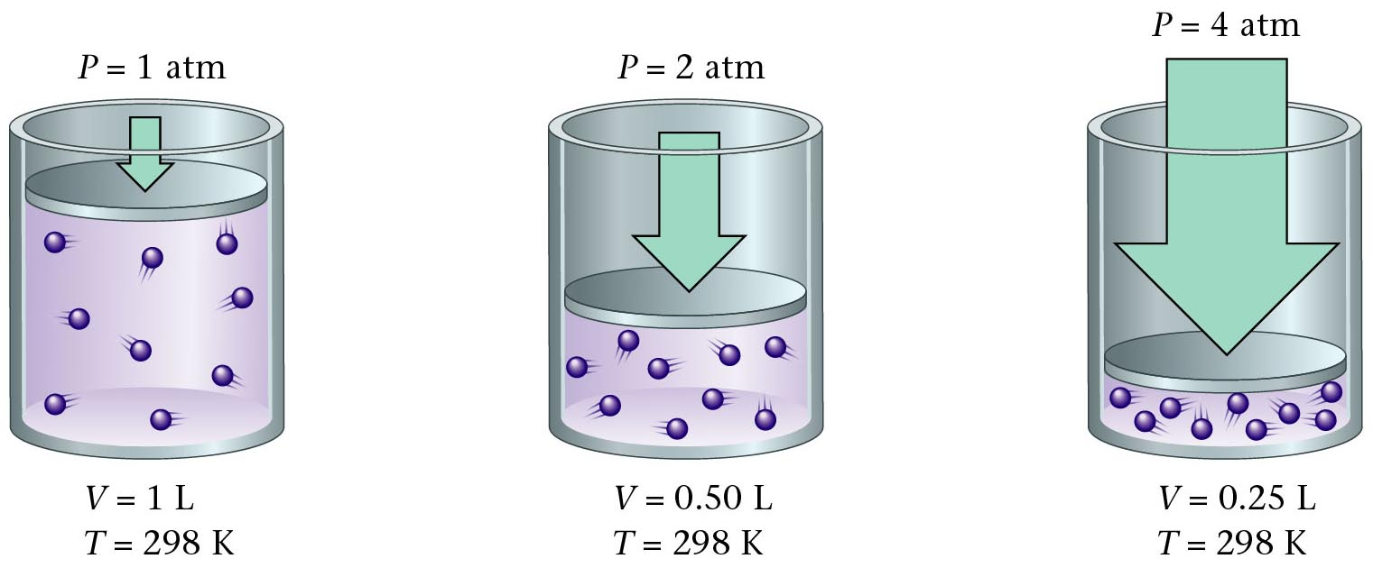
Boyle’s Law Illustrated
Zumdahl, Zumdahl, DeCoste, World of Chemistry 2002, page 404
Notes:
http://images.jupiterimages.com/common/detail/56/84/23298456.jpg

Slide 3
Pressure vs. Volume for a Fixed Amount of Gas (Constant Temperature)
600
500
400
300
Volume (mL)
200
100
0 100 200 300 400 500
Pressure (KPa)
Notes:
The pressure for this data was NOT at 1 atm.
Practice with this data: (where Pressure = 1 atmosphere)
Volume Temp (ºC) (K) V/T
63.4 L 500 773 0.0821
55.2 400 673 0.0821
47.0 300 573 0.0821
38.8 200 473 0.0821
As the pressure on a gas increases, the volume of the gas decreases because the gas particles are forced closer together.
As the pressure on a gas decreases, the gas volume increases because the gas particles can now move farther apart.
Boyle carried out some experiments that determined the quantitative relationship between the pressure and volume of a gas.
Plots of Boyle’s data showed that a simple plot of V versus P is a hyperbola and reveals an inverse relationship between pressure and volume; as the pressure is doubled, the volume decreases by a factor of two.
Relationship between the two quantities is described by the equation PV = constant.
Dividing both sides by P gives an equation that illustrates the inverse relationship between P and V:
V = constant = constant(1/P) or V ∝ 1/P
P
• A plot of V versus 1/P is a straight line whose slope is equal to the constant.
• Numerical value of the constant depends on the amount of gas used in the experiment and on the temperature at which the experiments are carried out.
• This relationship between pressure and volume is known as Boyle’s law which states that at constant temperature, the volume of a fixed amount of a gas is inversely proportional to its pressure.

Slide 4
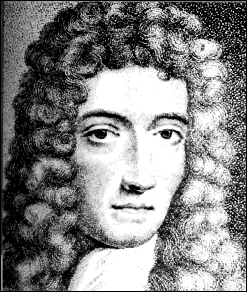
Boyle’s Law
The pressure and volume of a gas are inversely related at a constant temperature.
P₁V₁= P₂V₂
P
V
Courtesy Christy Johannesson www.nisd.net/communicationsarts/pages/chem
Notes:
As the pressure on a gas increases, the volume of the gas decreases because the gas particles are forced closer together.
As the pressure on a gas decreases, the gas volume increases because the gas particles can now move farther apart.
Boyle carried out some experiments that determined the quantitative relationship between the pressure and volume of a gas.
Plots of Boyle’s data showed that a simple plot of V versus P is a hyperbola and reveals an inverse relationship between pressure and volume; as the pressure is doubled, the volume decreases by a factor of two.
Relationship between the two quantities is described by the equation PV = constant.
Dividing both sides by P gives an equation that illustrates the inverse relationship between P and V:
V = constant = constant(1/P) or V ∝ 1/P
P
• A plot of V versus 1/P is a straight line whose slope is equal to the constant.
• Numerical value of the constant depends on the amount of gas used in the experiment and on the temperature at which the experiments are carried out.
• This relationship between pressure and volume is known as Boyle’s law which states that at constant temperature, the volume of a fixed amount of a gas is inversely proportional to its pressure.

Slide 5
Pressure and Volume of a Gas Boyle’s Law
A quantity of gas under a pressure of 106.6 kPa has a volume
of 385 L. What is the volume of the gas at standard
pressure(1 atm), if the temperature is held constant?
P₁ x V₁ = P₂ x V₂
(106.6 kPa) x (385 L) = (101.3 kPa) x (V₂)
V₂ = 405.14 L = 405L

Slide 6
Boyle’s Law
A quantity of gas has a volume of 120 L when confined
under a pressure of 93.3 kPa. At what pressure will the
volume of the gas be 30.0 L?
P₁ x V₁ = P₂ x V₂
(93.3 kPa) x (120 L) = (P₂) x (30.0L)
P₂ = 373.2 kPa = 370 kPa

