Slide 1

Gases…
…In the atmosphere

Slide 2

Atoms and Molecules in Motion
GASES
  no definite shape or volume; they expand to fill their container.
Compressibility
  The volume of a gas can be greatly decreased.

Slide 3
Properties Continued
  Due to the lack of attraction between particles, gases have the ability to flow like liquids.
Low Density
  The density of a gas is about 1/1000th that of a solid or liquid.

Slide 4

Ideal Gas
Ideal gas – an imaginary gas that perfectly fits the gas laws.
Based on assumptions of the kinetic molecular theory.

Slide 5
Assumptions of Kinetic Molecular Theory
Ideal Gases:
Large numbers of tiny particles that are far apart.
  Occupy 1000 times more space than a solid or liquid.
  Most of its volume is empty space.
2. In continuous, rapid, random motion.
3. Particles have negligible volume.

Slide 6








4. Have perfectly elastic collisions with container walls.
5. Have no attractive or repulsive forces between gas particles. Theoretically cannot be liquefied.
  Similar to pool balls

Slide 7
Kinetic Molecular Theory
The kinetic molecular theory is how temperature affects the motion of gas particles.
As you increase temperature, you increase the speed of the particles and the amount of space it takes up.
As you decrease the temperature, you decrease the speed and the amount of space it takes up.

Slide 8
Kinetic Molecular Theory
The two metric temperature scales in science are Celsius and Kelvin. The increments are the same on both thermometers but one starts at
-273 Celsius and the other at 0 Kelvin.
The Kelvin scale is used in gas laws as 0 Kelvin = 0 speed and 0 volume.
Degrees Celsius + 273 = Kelvin temperatures

Slide 9
Kinetic Molecular Theory
The kinetic molecular theory applies only to ideal gases which do not actually exist.
Real gases change to liquids and solids when temperatures or pressures get to high or low. “Ideal” (perfect) gasses stay gasses under all conditions-that is why they
do not exist in nature.

Slide 10
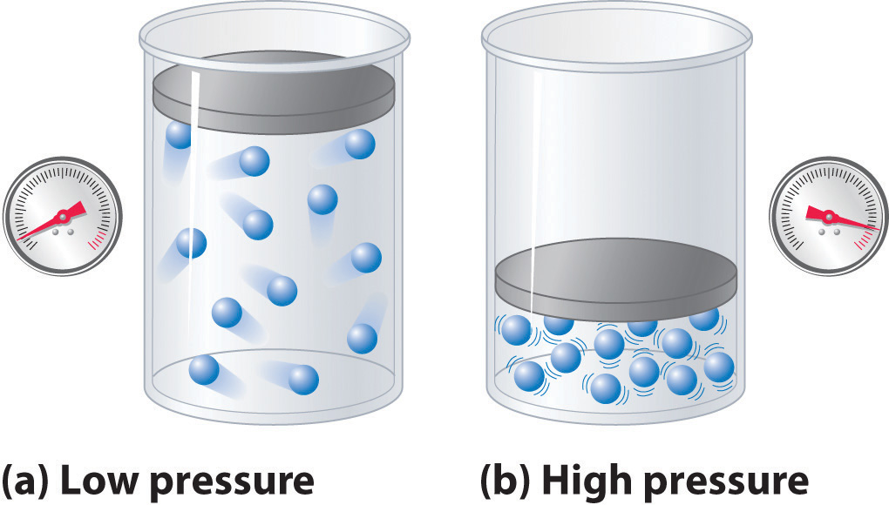
Real Gases are most like Ideal gases when:
1. Pressure is low
2. Temperature is high

Slide 11
Real Gas | Ideal Gas
Particles have volume | Particles have no volume
Small attraction between particles | No attraction
Heat lost to surroundings | Perfectly elastic collisions: no heat transferred to surroundings

Slide 12
PRESSURE
Pressure = Force
Area

Slide 13
Example
Someone steps on your foot
The pressure (or pain) you feel depends on:
  Force (how heavy is the person on your foot)
  Area (the shoe type)

Slide 14

Which would you prefer?
150 lb woman with high heels
150lb woman with roller blades
150 lb woman with flippers

Slide 15
The force is the same (150 lb woman) the area is different
Pressure = Force
Area
The bigger the area, the less force

Slide 16
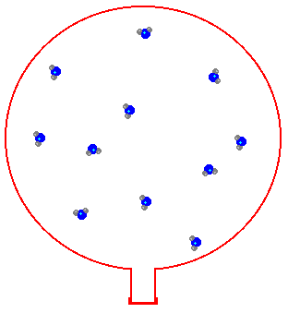
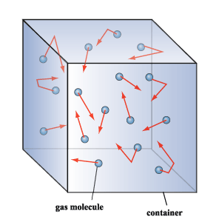
Molecules in gases aren’t very attracted to one another
Collisions of molecules with container walls produce gas pressure
Air Pressure: the combined force of air molecules as they strike the container wall

Slide 17
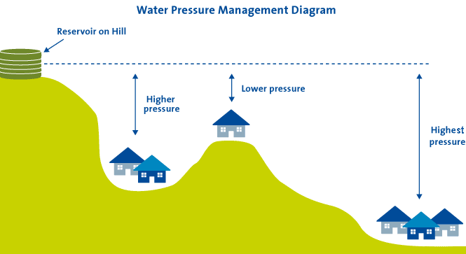
Under Pressure

Slide 18


Driving in the mountains, a big hill, on an airplane, an elevator?
Have your ears ever popped when you were….

Slide 19

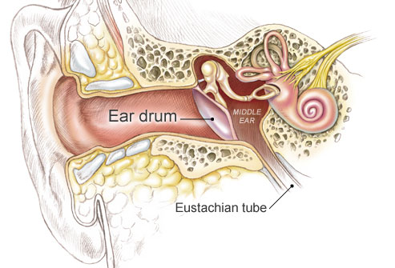
This is due to pressure changes
As you ascend in an airplane and the air pressure decreases, the air trapped in your inner ear will cause your eardrums to push outward.

Slide 20
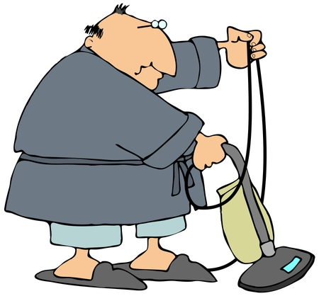
Did you know there is no such thing as suction?!
A vacuum is the absence of air.
Therefore your vacuum cleaner does not suck dirt up, dirt is pushed in by atmospheric pressure.

Slide 21
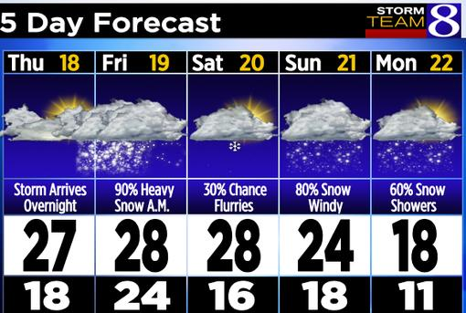
Low Pressure vs High Pressure?

Slide 22
Measuring Air Pressure
Barometer: measures air pressure in millimeters of mercury (mm Hg): English is inches of Hg

Slide 23
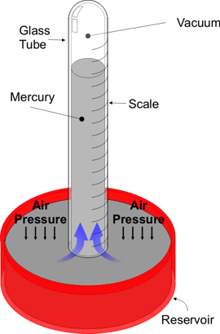
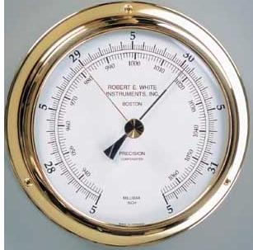
How does it Work?

Slide 24

Chemists use a different unit called the Atmosphere (atm)
1 atm = 760mmHg
(Normal air pressure at sea level)

Slide 25
Other Units of Pressure
PSI-Pounds per square inch
(bikes/car tires)

Slide 26
3 ways to measure Pressure!
  760mmHg = 1 atm = 101.3 kPa
3
1 atm is considered standard pressure from which all pressures are compared.

Slide 27
Converting between units of pressure
Convert 0.875atm to mmHg
  We know we have 0.875 mmHg
  We use the ratio - there are 760mmHg in one atm

Slide 28
Converting between units of pressure
Convert 0.875atm to mmHg
0.875atm X 760.0mmHg =
665 mmHg
1 atm

Slide 29
Converting between units of pressure
Convert 745.0 mmHg to atm.
(760.0 mmHg in 1 atm)
745.0 mmHg x 1atm =.
.9803 atm
760.0mmHg

Slide 30
Converting between units of pressure
Convert 0.955atm to kPa
(101.3 kPa in 1 atm)
0.995 atm X 101.3 kPa =
101 kPa
1atm

Slide 31
Converting between units of pressure
Convert 98.35 kPa to atm
(101.3 kPa in 1 atm)
98.35 kPa x 1atm = .
0.9709 atm
101.3kPa

Slide 32
Converting between units of pressure
Convert 740 mmHg to kPa
(760.0mmHg is = 101.3 kPa)
40.0mmHg x 101.3 kPa =
5.33 kPa
760mmHg

Slide 33
Converting between units of pressure
Convert 99.25 kPa to mmHg
(760.0mmHg is = 101.3 kPa)
99.25 kPa x 760.0mmHg =
744.6 mmHg
101.3 kPa

