Slide 1
Unit 13: Acids and Bases
Characterization
Naming

Slide 2
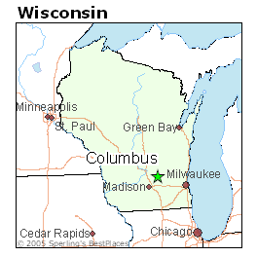
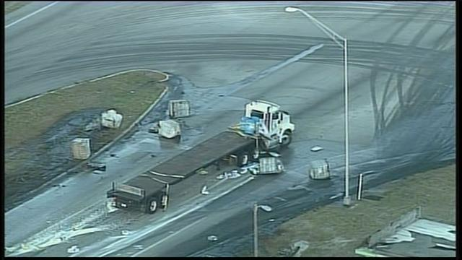
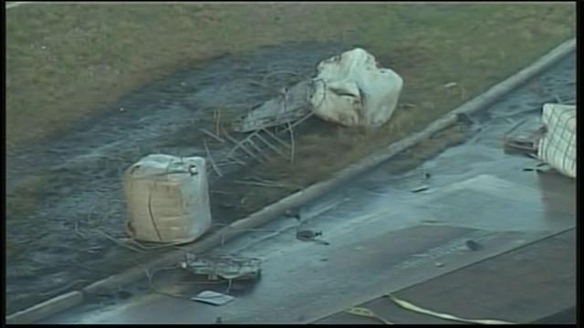
Acid Spill Links
http://www.columbuschemical.com/catalog/
http://www.wtsp.com/news/breaking/article/252528/20/Chemical-spill-shuts-down-major-highway-

Slide 3
Create a list of 10 acids and bases you can think of with the people at your table.

Slide 4
Characteristics
Acids
Tart or sour taste
pH 1 – 6
Corrosive
H⁺ ions
-ic or -ous
Reacts with metals

Slide 5
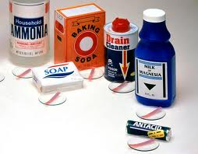
Characteristics
Bases
Bitter
Slippery
pH 8 – 14
Caustic
OH⁻ ions
Hydroxide
Most are hazardous

Slide 6
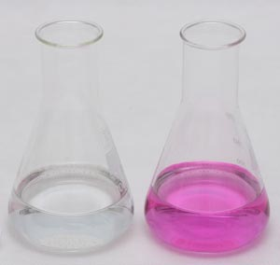
Characteristics Shared by Both Acids and Bases
Strong or weak electrolytes dependent on the number of ions present
Cause indicator color changes – will be observed in lab
Phenolphthalein
Litmus paper
pH paper
Bromothymol Blue
Cabbage Juice

Slide 7
Strong Acids and Bases vs. Weak Acids and Bases
The more an acid or base dissociates (breaks apart) in solution the more ions it releases causing it to be “stronger”
Concentration is NOT the same as “strength”
Strong Acid: HCl → H⁺ + Cl⁻
Complete dissociation – all ions - irreversible
Weak Acid: HC₂H₃O₂ H⁺ + C₂H₃O₂ –
Partial dissociation – some ions - reversible

Slide 8
Self-Ionization of Water H₂0 H⁺ + OH⁻ Equal amounts of H⁺ and OH⁻
Concentration = [H⁺] = [OH⁻] = 1.0 x 10⁻⁷M
Therefore water is neutral
If [H⁺] > [OH⁻] it is acidic
If [H⁺] < [OH⁻] it is basic

Slide 9
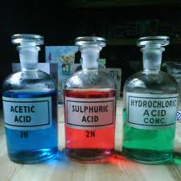
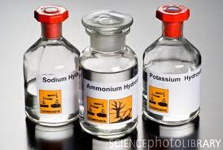
Naming and Formulas of Acids and Bases

Slide 10
Naming Binary Acids (acids ending in a single element)
The name of the binary acid consists of two words.
The first word has three parts:
the “hydro” prefix
the root of the nonmetal element
the “ic” ending the second word is always “acid”
Examples:
HCl = hydrochloric acid
HBr = hydrobromic acid
HF = hydrofluoric acid

Slide 11
Naming Oxyacids
These are more difficult to name because these acids have hydrogen, a nonmetal, and may have varying numbers of oxygen atoms.
The “ate” ions make the “ic” acids
Examples:
SO₄ ²⁻ = sulfate ion H₂SO₄ = sulfuric acid
NO₃ ⁻ = nitrate ion HNO₃ = nitric acid
PO₄ ³⁻ = phosphate ion H₃PO₄ = phosphoric
acid

Slide 12
The “ite” ions make the “ous” acids
Examples:
SO₃ ²⁻ = sulfite ion H₂SO₃ = sulfurous acid
NO₂ ⁻ = nitrite ion HNO₂ = nitrous acid
PO₃ ³⁻ = phosphite ion
H₃PO₃ = phosphorous acid

Slide 13
Formula Writing of Acids
Acids are ionic compounds
Acids always begin with H⁺ ions and end with an anion
Balance the charges
Examples: Give formula for chlorous acid, hydroselenic acid, and carbonic acid

Slide 14
Naming and Formula Writing for Bases
Bases are ionic compounds
Charges must cancel out!
Bases will start with a cation – usually a metal
Bases end with OH⁻ ions
Examples: Give formulas for barium hydroxide, ammonium hydroxide, and aluminum hydroxide

