Slide 1
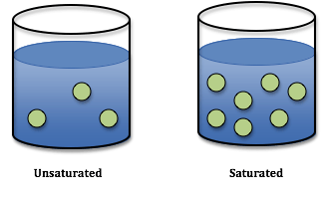
Types of Solutions
Unsaturated –
A solvent contains less than the maximum amount of solute at a given temperature.
Saturated – A solvent contains the maximum amount of solute at a given temperature – no more can dissolve.

Slide 2
SUPERSATURATED SOLUTIONS contain more solute than is possible to be dissolved Supersaturated solutions are unstable. The supersaturation is only temporary, and usually accomplished in one of two ways: Warm the solvent so that it will dissolve more, then cool the solution Evaporate some of the solvent carefully so that the solute does not solidify and come out of solution.

Slide 3
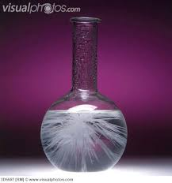
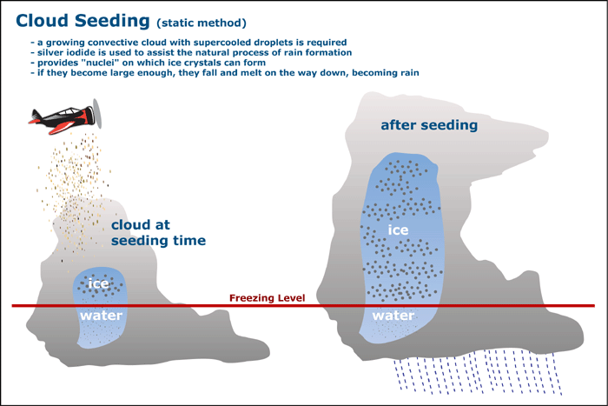
Recrystallization

Slide 4
Supersaturation Videos
https://www.youtube.com/watch?v=1y3bKIOkcmk
https://www.youtube.com/watch?v=9jUIedNOet0

