Slide 1
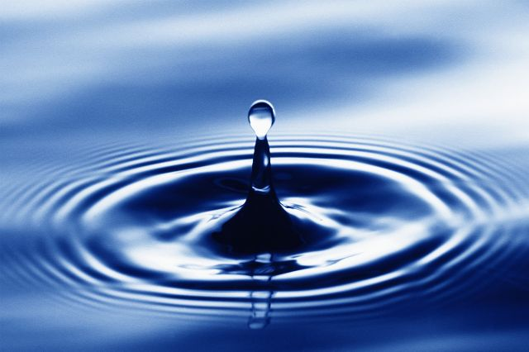
Properties of Water

Slide 2
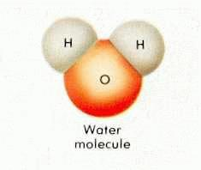
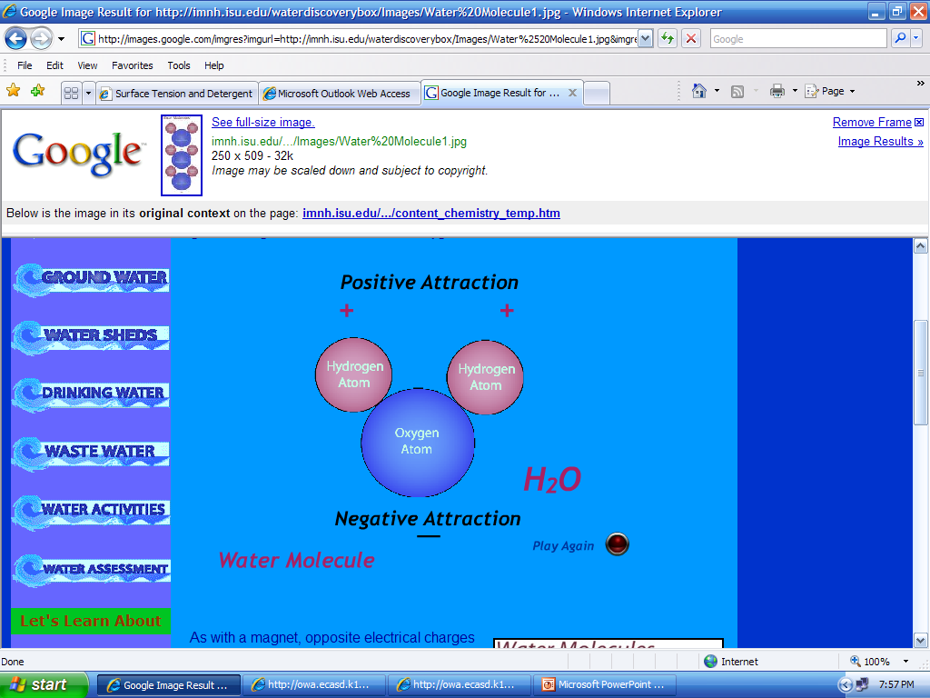
Structure of Water
A molecule of water is made up of 2 hydrogen atoms and 1 oxygen atom
Each atom carries a charge
  Oxygen has a negative charge
  Hydrogen has a positive charge

Slide 3
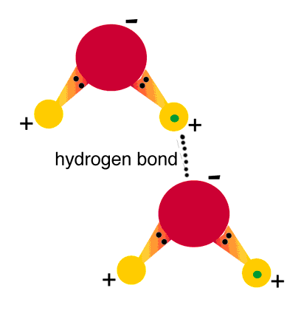
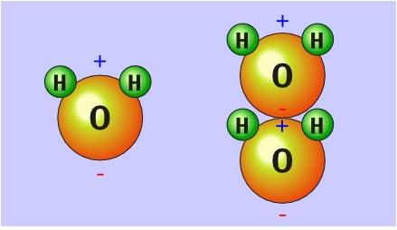
Water molecules are held together by hydrogen bonds
  One end is positively charged (where the 2 hydrogens are)
  One end is negatively charged
  Hydrogen bond forms between a hydrogen atom from one molecule and an oxygen atom from another molecule
  *Remember opposites attract!!

Slide 4
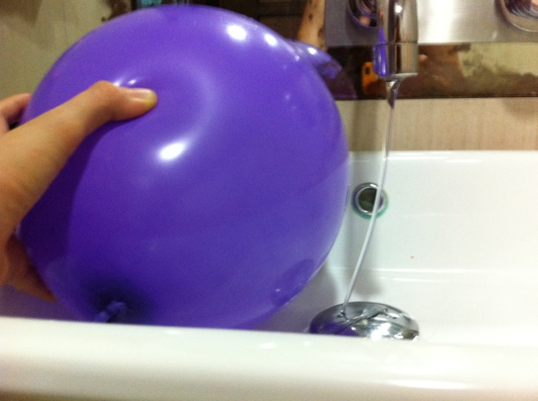
Polarity
Water acts like a magnet: it has a positively charged side and a negatively charged side
Because water is polar it is effected by static electricity

Slide 5
Water can form Drops
1 water molecule attaches to another water molecule and so on and so on; the attraction is due to the hydrogen bonding. More water molecules causes the water droplets to grow in size!!

Slide 6
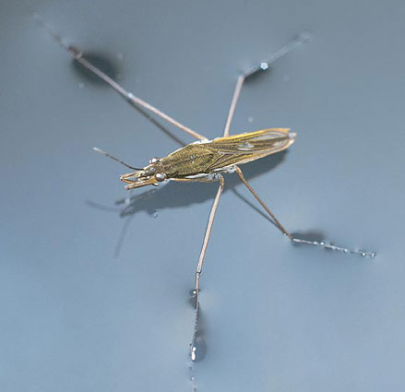
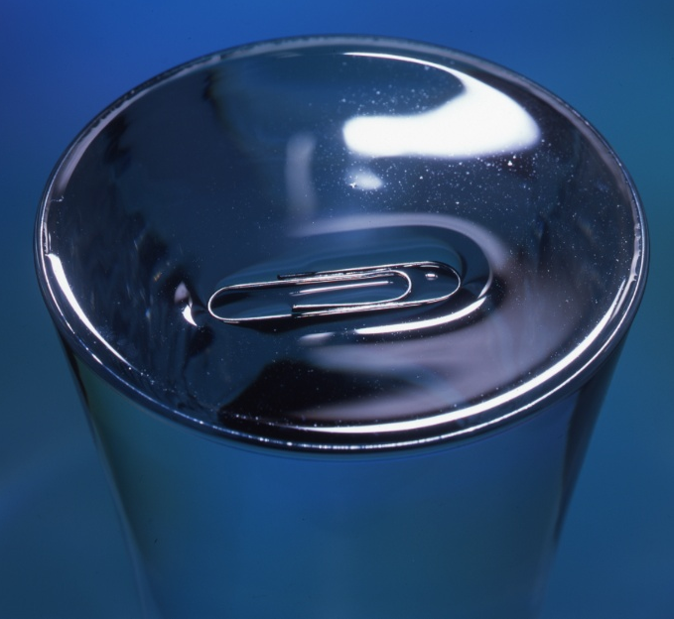
Surface Tension
Surface tension is created because of hydrogen bonding
Water molecules are bonded tightly at the surface of water forming a “skin” making it more difficult to break through
Surfactant (soap) breaks surface tension

Slide 7
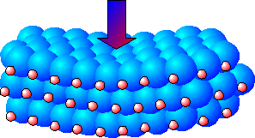
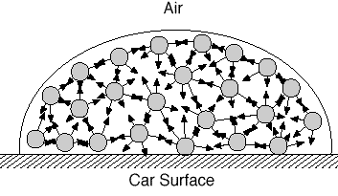
https://www.youtube.com/watch?v=rTQ9CDuXKW8

Slide 8
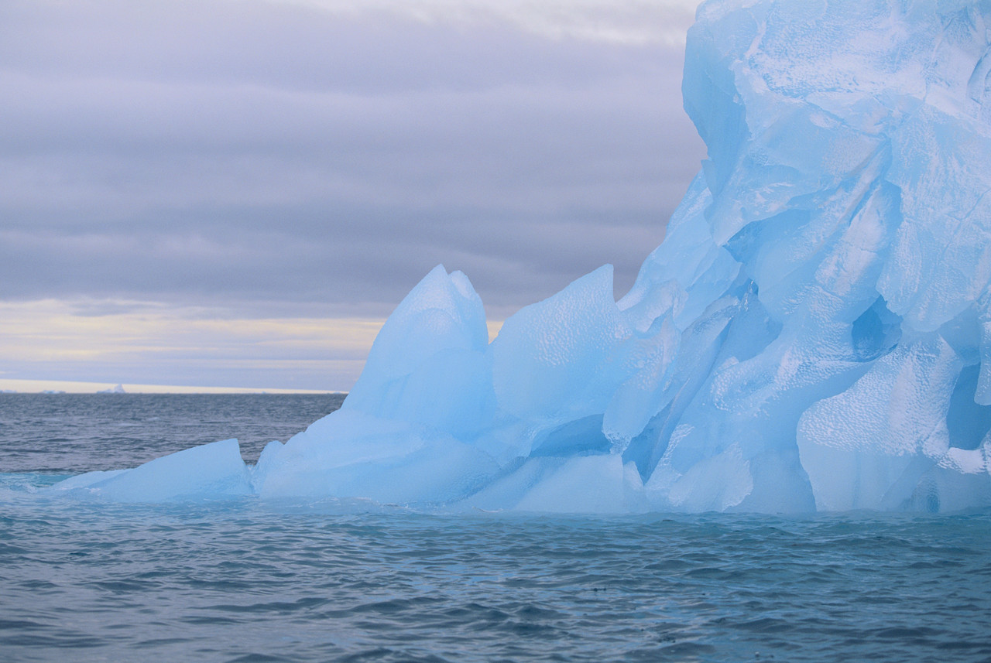
Freezing & Boiling Points
Freezing Point - 0ºC or 32ºF
High Boiling Point - 100ºC or 212ºF
Due to the hydrogen bonds holding the water molecules in tight as a liquid rather than allowing them to gain enough energy to escape as a gas molecule

Slide 9
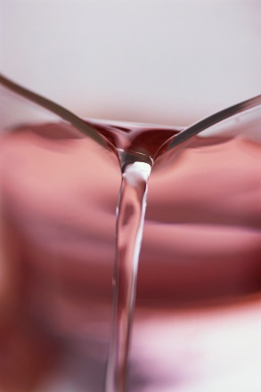
Low Vapor Pressure
Vapor Pressure – The pressure directly above a liquid as it evaporates
Water has a low vapor pressure because it does not evaporate very easily due to the hydrogen bonds…the +/- attraction holds the molecules together

Slide 10

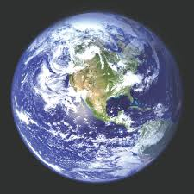
Specific Heat
Water has a high specific heat index
  This means that water can absorb a lot of heat before it gets hot due the hydrogen bonding; swimming in the lake in the spring
  It can also hold heat for a long time; takes a long time for ice to form in the fall.
  Feel a cool breeze off the lake on the hot days of the summer…
  Moderates the climate – keeps earth from getting too hot or too cold!

Slide 11
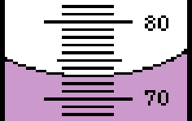
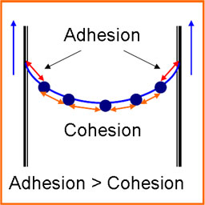
Meniscus
Hydrogen Bonds cause water to create a meniscus in a graduated cylinder or glass of water
The water is pulled up the sides of the glass due to the +/- attraction between the molecules
  Adhesion – water wants to stick to other substances
  Cohesion – water wants to stick to itself

Slide 12

Capillary Action
The ability of water to be “drawn up” materials due to the +/- attraction between the molecules
Examples: plant roots/stems, water on the cuff of your pant legs in the rain will cause your pant to be wet to your ankles, paper towels

Slide 13
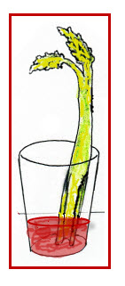
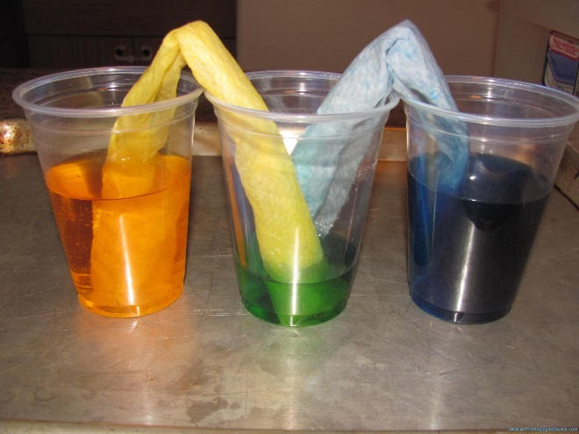
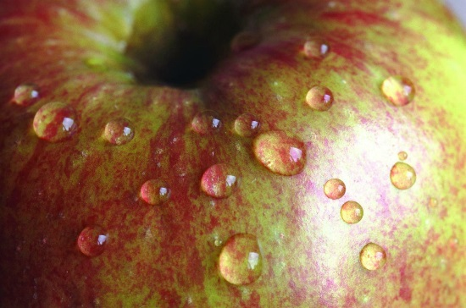
Capillary Action
Moves water through porous materials
Due to:
  Surface tension
  Adhesion
  Cohesion
Water molecules will “stick” together in a drop on other materials

Slide 14
Low Molar Mass
Water as a liquid has a low molar mass compared to other liquids due to the hydrogen bonding (+/- attraction) compared to other materials that do not have hydrogen bonding.
Materials without hydrogen bonding tend to exist as gases.

Slide 15
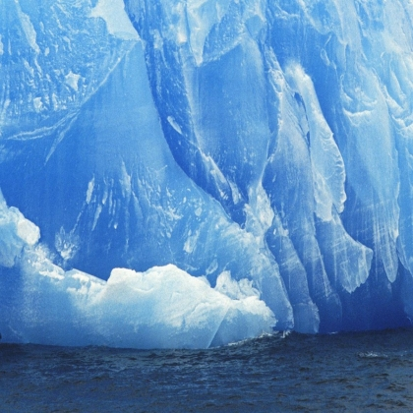
Ice
Ice is less dense than liquid water
The volume increases so it becomes less dense
Water expands as it freezes to accommodate the bent structure of the water molecule and the attraction between molecules
It forms a honeycomb (hexagonal) crystal structure

Slide 16
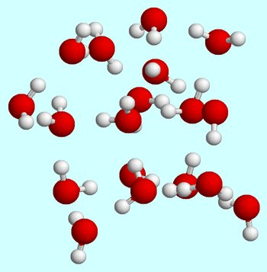
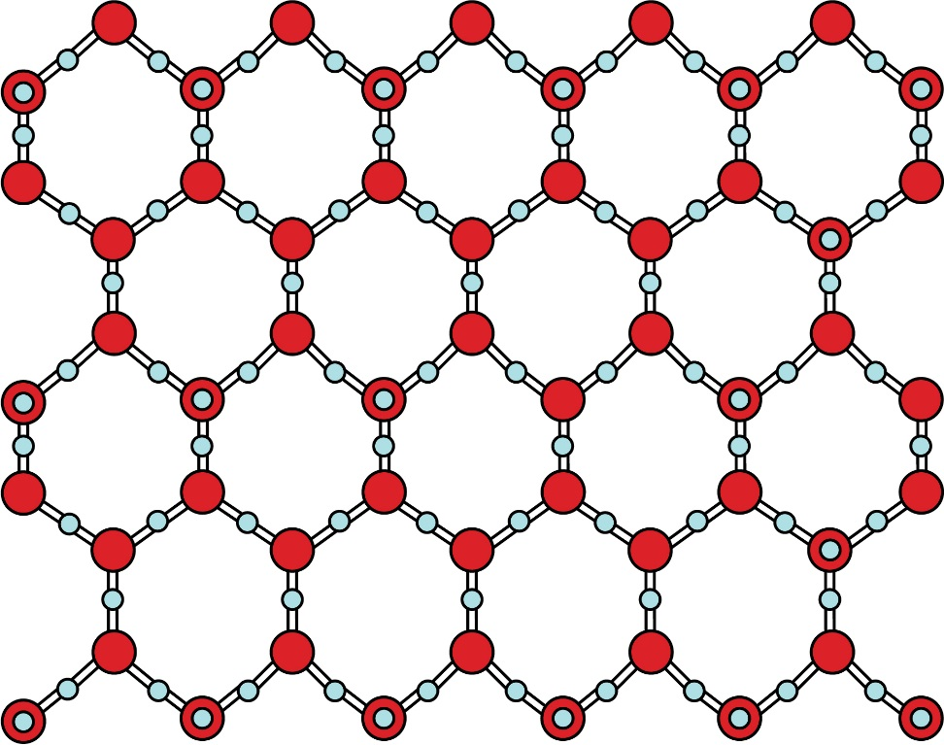
Solid Water (Ice) honeycomb structure
Liquid Water
https://www.youtube.com/watch?v=fUot7XSX8uA

Slide 17
Solvent
Water is the universal solvent because it dissolves more substances than anything else
  This is due to the polarity (molecule that has a positive and negative side) of water
  Like Dissolves Like – water tends to dissolve other polar or ionic substances due to attraction between particles
Water surrounds other polar molecules and breaks the molecule apart – dissolving it
  The molecule breaks apart because it is attracted to the water

Slide 18
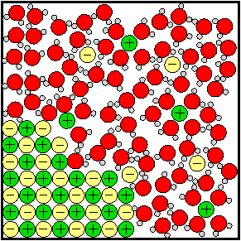
Water Dissolving an Ionic Compound
Water surrounding ions within salt and breaking it apart
https://www.youtube.com/watch?v=EBfGcTAJF4o

Slide 19
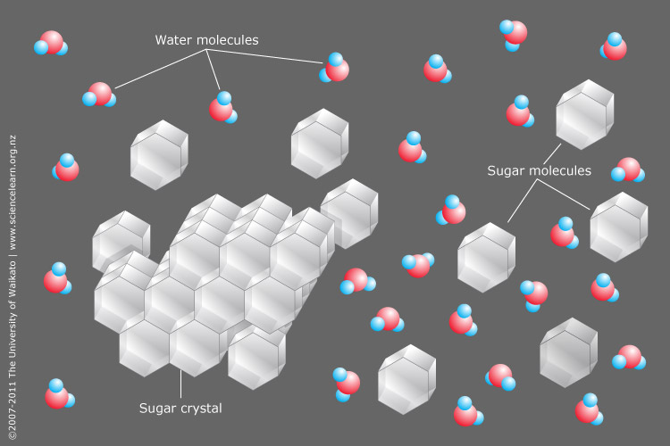
Water Dissolving a Polar Molecule
Water surrounds polar molecules of sugar

