Slide 1
Homecoming 2018
September 24-29

Slide 2
Dress up days
Monday: Pajama Day
Tuesday: TV Tuesday-dress like an actress/actor from a TV show
Wednesday: Winter Day
Thursday: Hawaiian Day
Friday: Spirit Day

Slide 3
Other events
The Powder Puff Football game at 6:30 at Carson Park on Wednesday.
The Varsity Show at 7:00 pm on Thursday.
The Pep Assembly 2:21-2:58 pm on Friday.
The Homecoming parade starting at 5:00 pm (lineup between 3:30-4:30) with a tailgate party in the Carson Park parking lot following.
The game on Friday at 7:00 pm (vs. North).
The Homecoming Dance on Saturday 7-11 pm
Theme: TV Shows

Slide 4
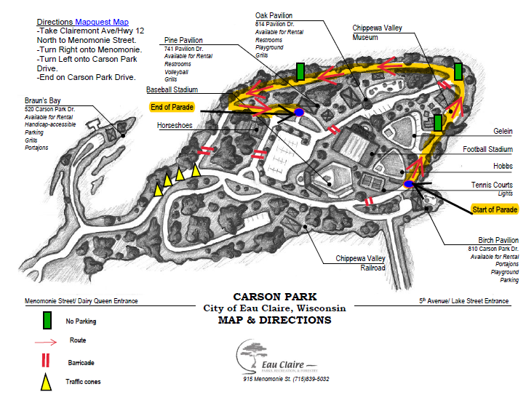
Parade Route

Slide 5
Positive Behavior Expectations for the Varsity Show
Remain quiet during performances.
Applaud/laugh/participate at appropriate times.
Stay seated until the intermission or conclusion.
Turn off cell phones and put them away.
Be respectful to the performers (avoid heckling).

Slide 6
Positive Behavior Expectations at Sporting Events
Cheer and talk respectfully.
Keep walkways clear and your belongings with you.
Respect the refs and opponents.
Respect the facilities and keep them clean.
Avoid excessive PDA.

Slide 7
Positive Behavior Expectations for the Dance:
Remember school id and tickets.
Follow the school dress code.
Event staff will be strictly enforcing the appropriate attire dress code at Memorial dances. Appropriate attire includes: Formal wear that would be acceptable at a formal public venue – such as weddings, out to dinner, church, etc. Unacceptable attire includes, but not limited to, undergarments showing or exposed cleavage. Administration reserves the right to refuse entrance to anyone they feel does not meet dress code guidelines.
Avoid excessive PDA.
Plan for transportation and leave when the event is over.
Stay in the designated areas.

Slide 8
More Homecoming Dance Information
Tickets for the dance are $10.00 and will be on sale by the library during all lunch shifts the week of Homecoming. Tickets will not be sold at the dance. Note: On Monday and Tuesday, Homecoming Dance tickets will be sold to MHS students only.
If a MHS student would like to bring a guest from another school, a Guest Form (available in attendance and student services)will need to be completed and approved by administration before Friday, September 28th. Ticket sales for guest will be Wednesday-Friday only.
As always, a student ID is required to purchase a ticket and to enter the dance.

