Slide 1
RESPECT
What is RESPECT? How do you define it? How do you show respect to others?
Respect is thinking and acting in a positive way about yourself or towards others. It is thinking and acting in a way that shows others you care about their feelings and their well-being.

Slide 2
What is the difference between treating someone with disrespect and bullying?
Teasing (funny to some but not to others), sarcasm, insensitive comments, name calling, and hurtful comments can cause pain to the individuals at the time, but in most cases this is not viewed as bullying behavior.
It is a hurtful incident-a disrespectful behavior, which will hopefully be resolved between the parties involved within a short period of time.
Bullying is different. Bullying is a situation in which someone intentionally and repeatedly harasses, makes fun of, or mistreats others either face to face or through social media.

Slide 3
Introduction to Bullying Video
Take a Stand

Slide 4
To help you understand the impact of bullying, we will be sharing some personal stories from Memorial High School students. Please listen respectfully.
The two individuals depicted in these videos have chosen to share their stories so that we can understand what they went through and how they handled it.
Although we want to discuss bullying in general, this is not the time for sharing the stories of others, especially when we do not have their permission to do so.
Video: Student Stories

Slide 5
What do you do if you feel you are being bullied? There are different responses based on the situation and people involved.
Laugh it off. If these are newer incidents of disrespect, often the person is seeking attention. By making a joke of the incident, you could diffuse the situation and minimize the attention the bully is seeking.
Ignore it. People who bully like the attention and/or audience that they get from their behaviors. Do not acknowledge what they said or wrote in any way.
Speak up. If ignoring the person doesn’t work, tell the person directly to stop. If you are too nervous doing this, ask a friend to do this on your behalf.
Unfriend the person on social media sites.
Keep a journal. If it happens verbally write it down. If it happens on social media, take a screen shot and keep it. Document with as much detail as possible. If the abuse continues report the abuse to abuse@(website).com Example: abuse@twitter.com Instagram and Facebook also have “Help”, “Safety” or “Contact” reporting sites. If you send your journal (social media) entries to the sites, they will often block or suspend the account the bully is using.

Slide 6
What to do continued….
Never retaliate: Provide evidence that the other person was bullying you. If you retaliate, it looks like you were both bullying.
Talk about it. Talk to a parent, teacher, coach, counselor, or friend. Never keep it to yourself. You need a support system. Give others a chance to come through for you.
When you must tell an adult: When you feel scared, feel threatened, when you want to avoid school or being with certain people, events or places, when you find that the situation is all you can think about, when the situation is negatively affecting your life, when you are depressed or if you feel suicidal. Please tell an adult.

Slide 7
Mental Health: It’s Part of All Our Lives
Mental health problems are health conditions involving changes in thinking, mood, or behavior.
Mental illnesses are common – they impact almost every family in America and can affect anyone regardless of age, culture, gender, ethnicity, or economic status.
Effective treatments are available and people recover.
Counter Stigma – Treat people with respect and dignity. Learn and share facts about mental health. Avoid labeling people by their diagnosis.

Slide 8
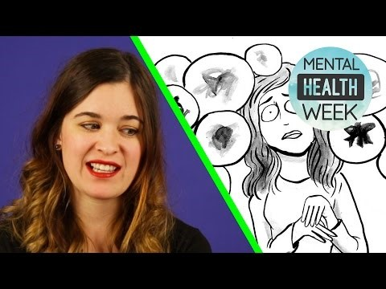
Mental Health and Wellness

Slide 9
A.C.T.

Slide 10
A.C.T.
Loss of interest in school and regular activities
Withdrawal from friends and family
Feelings of hopelessness, worthless, self-blame, or guilt
Angry, irritable mood
Feeling there is no way out; need to escape
Talking about not being around anymore, death, or suicide
If you notice these distress signals in a friend, it’s time to A.C.T.

Slide 11
A.C.T.
Acknowledge that your friend has a problem, and that symptoms are severe.
Care – Let your friends know that you’re there for them, and you want to help.
Tell a trusted adult about your concerns. It could make all the difference.

