Slide 1
Mental Health: It’s Part of All Our Lives
Mental health problems are health conditions involving changes in thinking, mood, or behavior.
Mental illnesses are common – they impact almost every family in America and can affect anyone regardless of age, culture, gender, ethnicity, or economic status.
Effective treatments are available and people recover.
Counter Stigma – Treat people with respect and dignity. Learn and share facts about mental health. Avoid labeling people by their diagnosis.

Slide 2
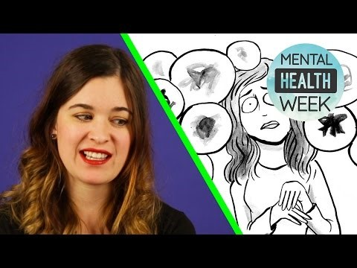
Mental Health and Wellness

Slide 3
A.C.T.

Slide 4
A.C.T.
Loss of interest in school and regular activities
Withdrawal from friends and family
Feelings of hopelessness, worthless, self-blame, or guilt
Angry, irritable mood
Feeling there is no way out; need to escape
Talking about not being around anymore, death, or suicide
If you notice these distress signals in a friend, it’s time to A.C.T.

Slide 5
A.C.T.
Acknowledge that your friend has a problem, and that symptoms are severe.
Care – Let your friends know that you’re there for them, and you want to help.
Tell a trusted adult about your concerns. It could make all the difference.

Slide 6
FAFSA-“ Free Application for Federal Student Aid”
Filling out the FAFSA is the Key to gaining Financial Aid from the Governement!
Three Types of Financial Aid
Grants = Free Money, never has to be repaid
Work Study- Money gained through employment on your campus
Loans- Money that has to be repaid. Discuss this option with Parents/Guardians
The FAFSA is FREE. If a website asks you to pay to fill it out, you’re not dealing with the official FAFSA website

Slide 7
Starting your FAFSA
Start/Renew Application: https://fafsa.ed.gov/
The Frist Step is to Obtain a FAFASA ID for you and your parents/guardians. You can do this at any time. Do it ASAP!
Make sure you have all the required documents for completion!
Your Social Security number
Your parents’/guardians’ Social Security numbers
Your driver’s license number if you have one (Alien Registration number if you are not a U.S. citizen)
Federal tax information or tax returns
Records of your untaxed income
Information on cash; savings and checking account balances; investments

Slide 8
Remember
Apply Early!
If you have questions visit: https://studentaid.ed.gov/sa/fafsa/filling-out

