Slide 1
Mental Health: It’s Part of All Our Lives
Mental health problems are health conditions involving changes in thinking, mood, or behavior.
Mental illnesses are common – they impact almost every family in America and can affect anyone regardless of age, culture, gender, ethnicity, or economic status.
Effective treatments are available and people recover.
Counter Stigma – Treat people with respect and dignity. Learn and share facts about mental health. Avoid labeling people by their diagnosis.

Slide 2
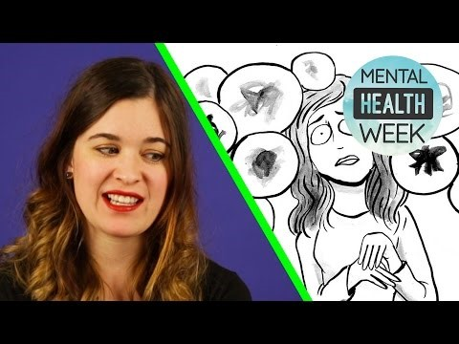
Mental Health and Wellness

Slide 3
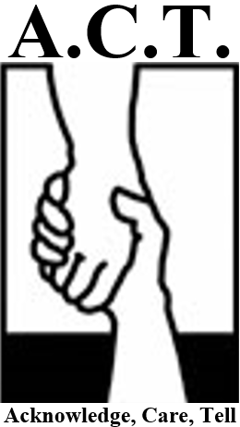
A.C.T.

Slide 4
A.C.T.
Loss of interest in school and regular activities
Withdrawal from friends and family
Feelings of hopelessness, worthless, self-blame, or guilt
Angry, irritable mood
Feeling there is no way out; need to escape
Talking about not being around anymore, death, or suicide
If you notice these distress signals in a friend, it’s time to A.C.T.

Slide 5
A.C.T.
Acknowledge that your friend has a problem, and that symptoms are severe.
Care – Let your friends know that you’re there for them, and you want to help.
Tell a trusted adult about your concerns. It could make all the difference.

Slide 7
MARCH 1st!!!
All 11th grade students will be taking the ACT plus Writing on March 1st, 2016
The ACT includes 215 multiple-choice questions and takes a little over four hours to complete. This will include two short breaks
The ACT tests students’ knowledge in English, Mathematics, Reading, Science, & Writing
Test |  |  | Content
English | 75 questions | 45 minutes | Measures English and rhetorical skills.
Mathematics | 60 questions | 60 minutes | Measures mathematical skills that students should have acquired by 12th grade.
Reading | 40 questions | 35 minutes | Measures reading comprehension.
Science | 40 questions | 35 minutes | Measures the skills required in natural science.
Writing | 1 prompt | 40 minutes | Measures writing skills emphasized in high school and entry-level college courses.

Slide 8
ACT WorkKeys
All 11th grade students will be taking the ACT WorkKeys Assessment on March 2nd!
The ACT WorkKeys test is a job skills assessment system that measures “Real World” work skills

Slide 9
Practice, Practice, Practice!
ACT General Information: http://www.actstudent.org/
ACT Question of the Day: http://www.act.org/qotd/
ACT Sample Questions: http://www.actstudent.org/sampletest/
Career Locker ACT Test Prep: https://wiscareers.wisc.edu/C_PracticeTests/acadTestPrep.asp?type=1
ACT Test Prep: http://www.mometrix.com/academy/act-test/
ACT Online Prep: http://www.act.org/onlineprep/
ACT Preparation Test Materials: Handed out at the registration meeting for students on February 11th
ACT Strategies Workshop When: February 14th 1:30- 4:30 Where: EC Room of Public Library
Blugold Beginnings Test Prep When: February 15th- 18th after school Where: Memorial High School

Slide 10
Tips
Carefully read all instructions and questions
Pace yourself
Don't spend too much time on a single passage or question
Pay attention to the time (there will be a 5 minute warning before time is up)
Answer the easy questions first, then go back and answer the more difficult ones if you have time remaining on that test
On difficult questions, eliminate as many incorrect answers as you can, then make an educated guess among those remaining
Answer every question. There is no penalty for guessing!
If you complete a test before time is called, recheck your work on that test

Slide 11
Dates to Remember!
February 11th - ACT Preregistration. DO NOT MISS THIS DAY!
March 1st- ACT Test day
March 2nd – ACT WorkKeys Test

