Slide 1
ECASD MIDDLE SCHOOL STEAM FAIR 2018
SCIENCE, TECHNOLOGY, ENGINEERING, ART, MATHEMATICS

Slide 2
Are you interested in…
Making a difference in your own home, school, community, and world?
Pursuing your passions for helping our world?
Challenging yourself?
Applying your scientific skills in a “real-world” way?
Taking ACTION!?
Then the 2018 STEAM fair may be for you!

Slide 3
Our Theme: ACTION!
Take ACTION! to help our Earth
Sustainability
Air and water quality
Human-environment interaction
Waste management
Any problem related to our world
Action!
This Photo by Unknown Author is licensed under CC BY-NC-ND This Photo by Unknown Author is licensed under CC BY-SA

Slide 4
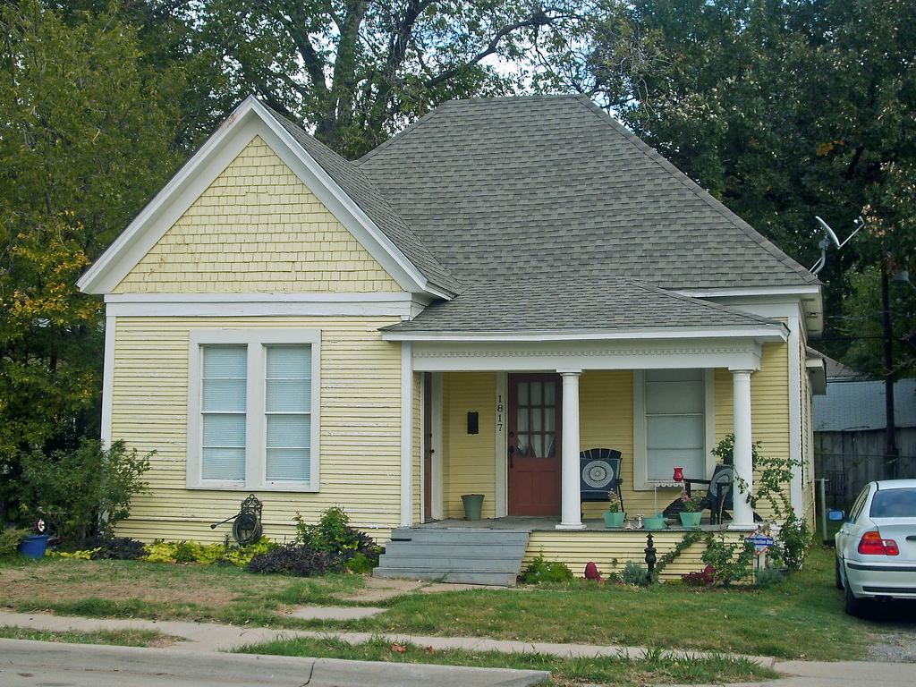
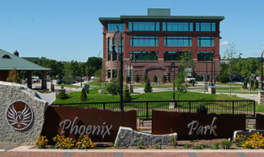
Think of a problem in…
YOUR SCHOOL
YOUR HOME
YOUR CITY
YOUR WORLD
DISCUSS: What is one problem you can think of relating to these places?

Slide 5
Pose a solution…
CHOOSE EITHER…
OR
Scientific Investigation
Students may conduct traditional experimental design project (with controlled variables)
or
They may conduct an observational study (variables are not changed)
Design Project
Design projects must identify and provide a solution to a problem. Students may carry out an engineering design project or another form of design (e.g., architecture, app design, computer program, graphic design, etc.)

Slide 6
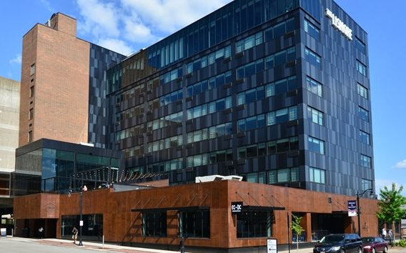
Details
WHEN: Monday, April 16th
12:00: Lunch and Speakers
2:00: Set-Up
4:00: Judging
5:00: Awards
WHO: any 6th, 7th, or 8th grade students from South, Delong, or North Star
WHERE: At the Lismore Hotel
** This fair is in partnership with the Chippewa Valley Sustainability Festival and Earth Week

Slide 7
Sign up for the STEAM fair and step up in ACTION!
Talk with your science teacher about signing up for this year’s STEAM Fair!
Click here for the STEAM promo video
Action!

